Slide 1

Translation, Seq2Seq, Attention

Slide 2
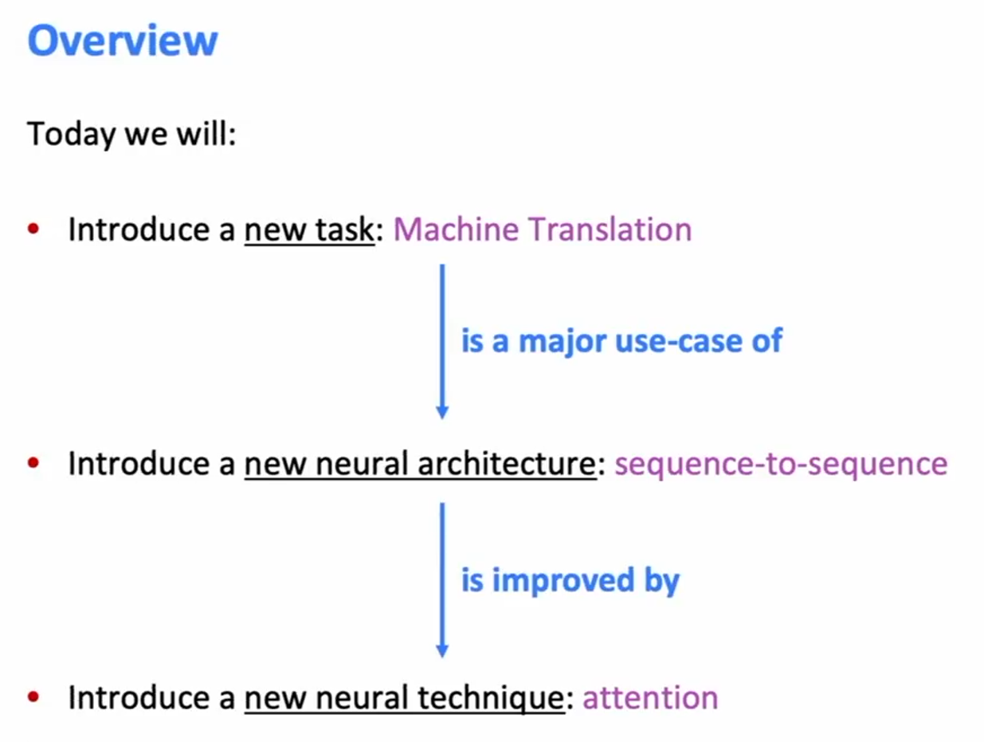
Overview

Slide 3


Slide 4
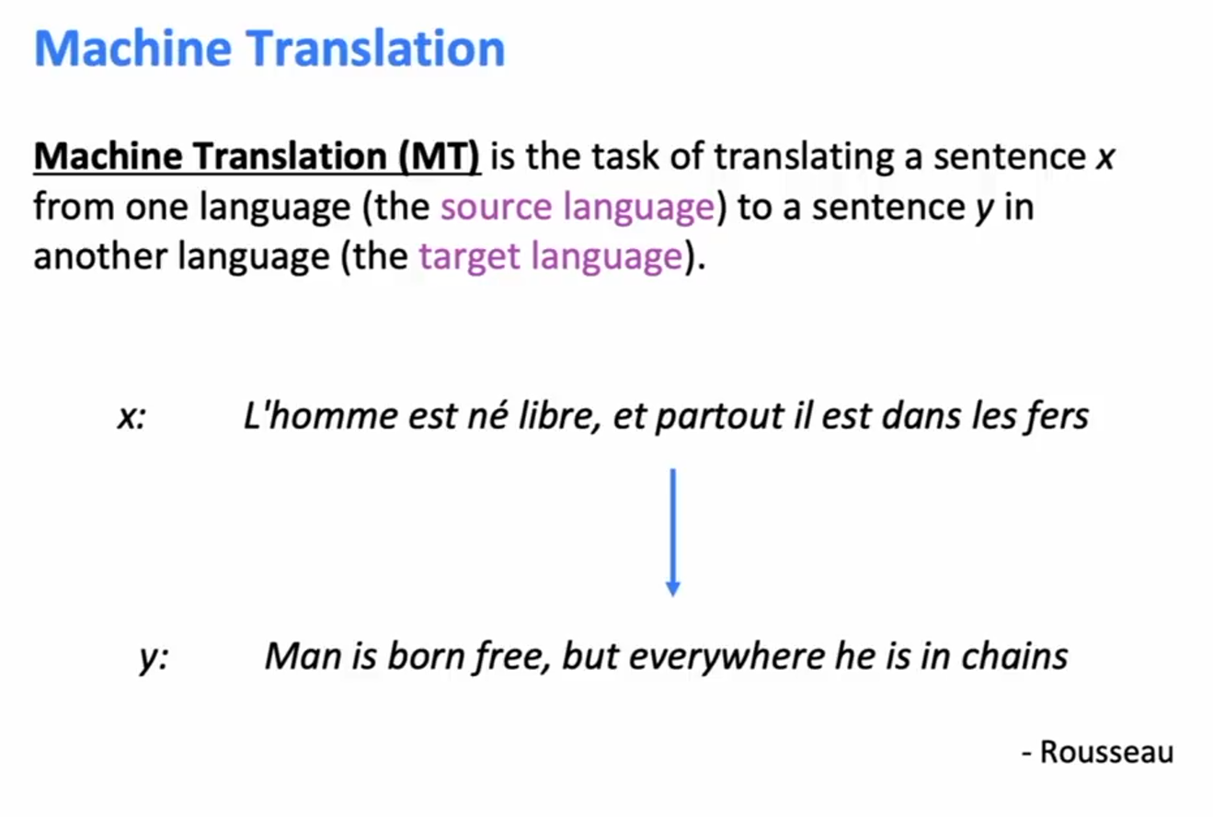
Pre-Neural Machine Translation

Slide 5
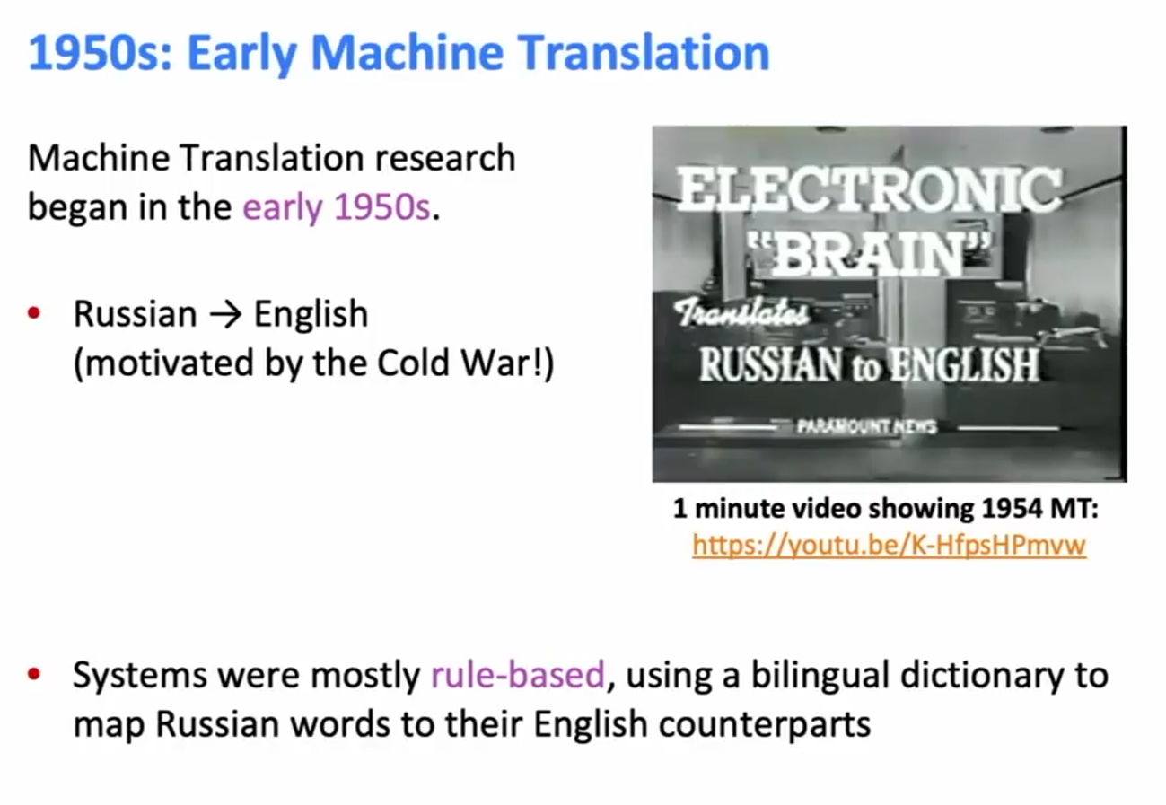
1950’s: Early Machine Translation

Slide 6
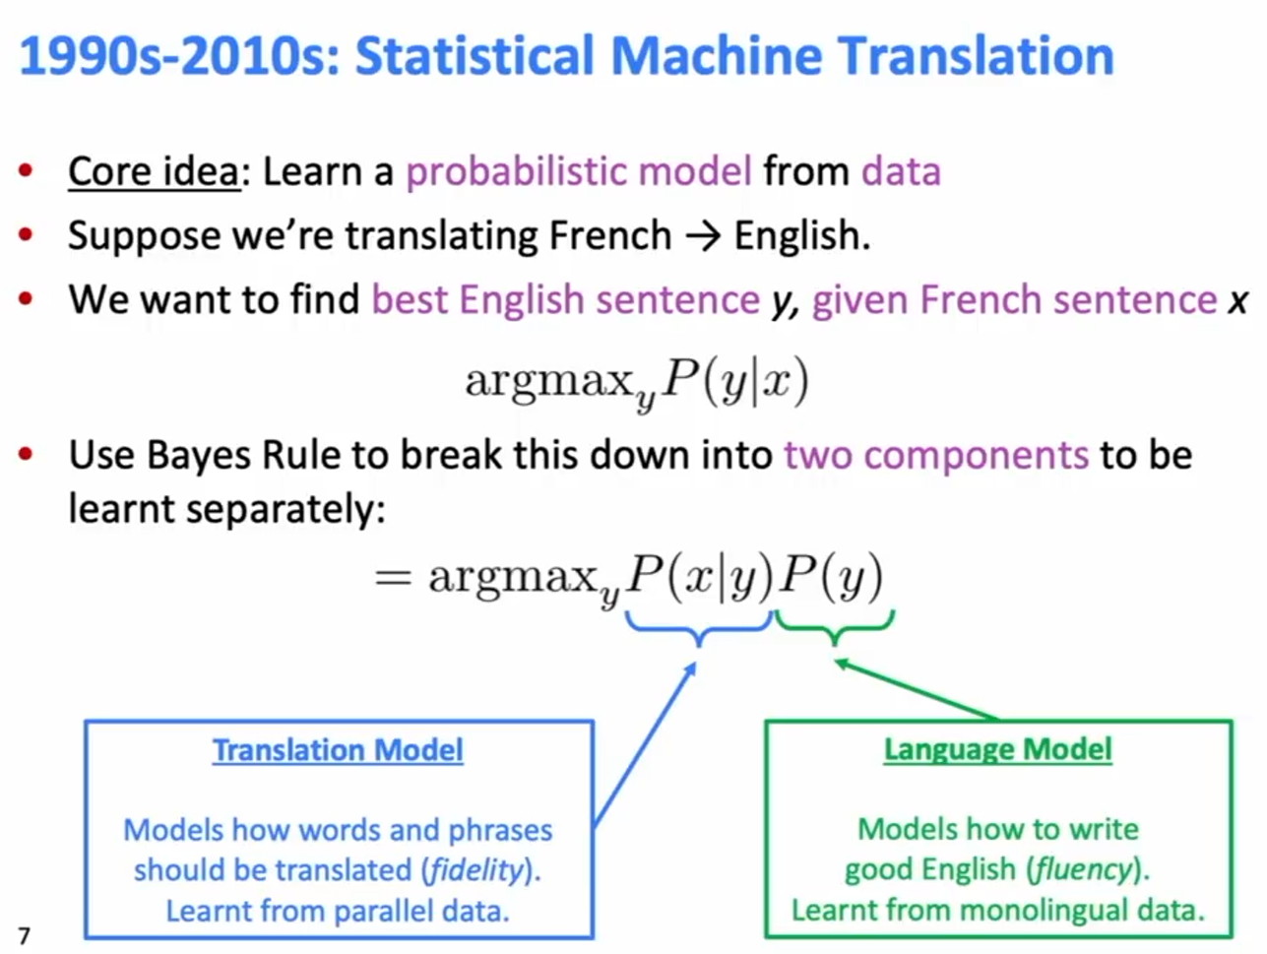
1990s-2010s: Statistical Machine Translation

Slide 7
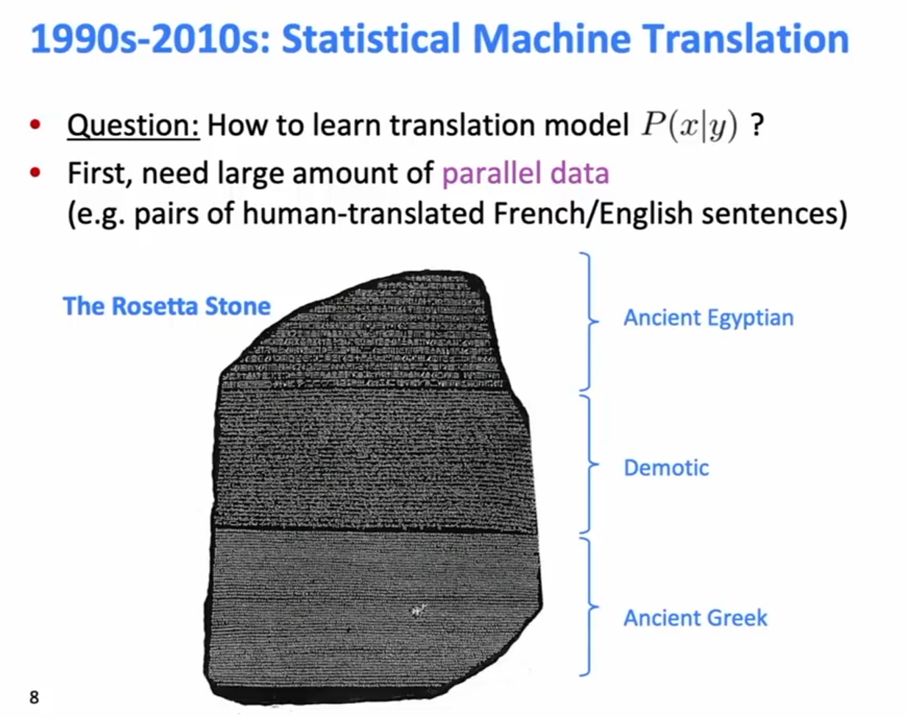
1990s-2010s: Statistical Machine Translation

Slide 8
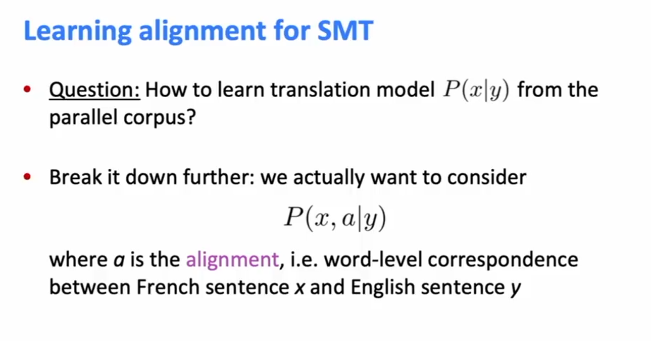
Learning alignment for SMT

Slide 9
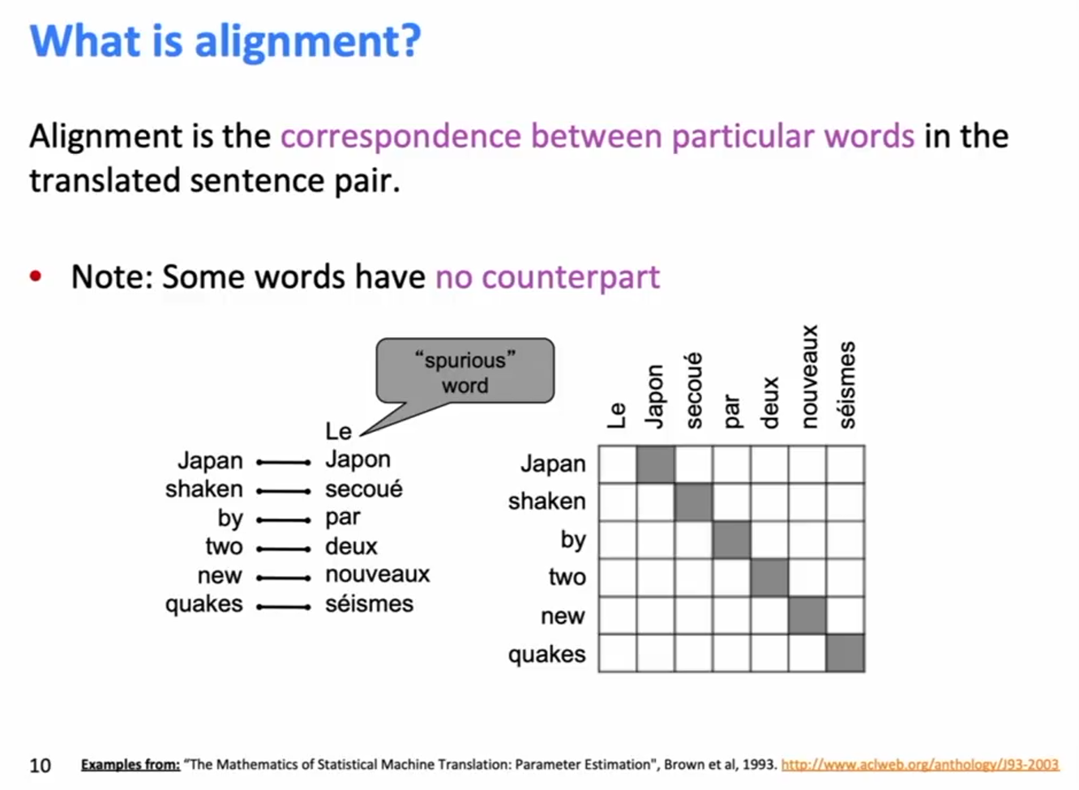
What is alignment?

Slide 10
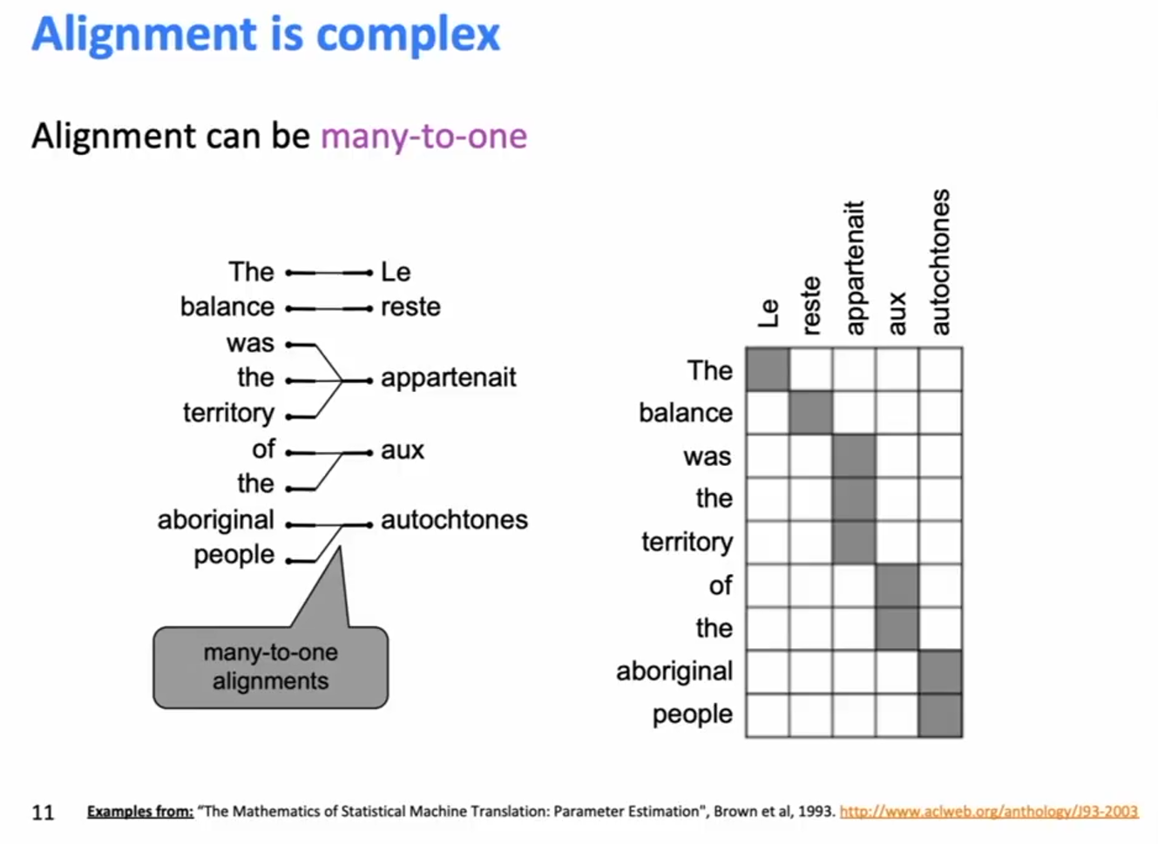
Alignment is complex

Slide 11
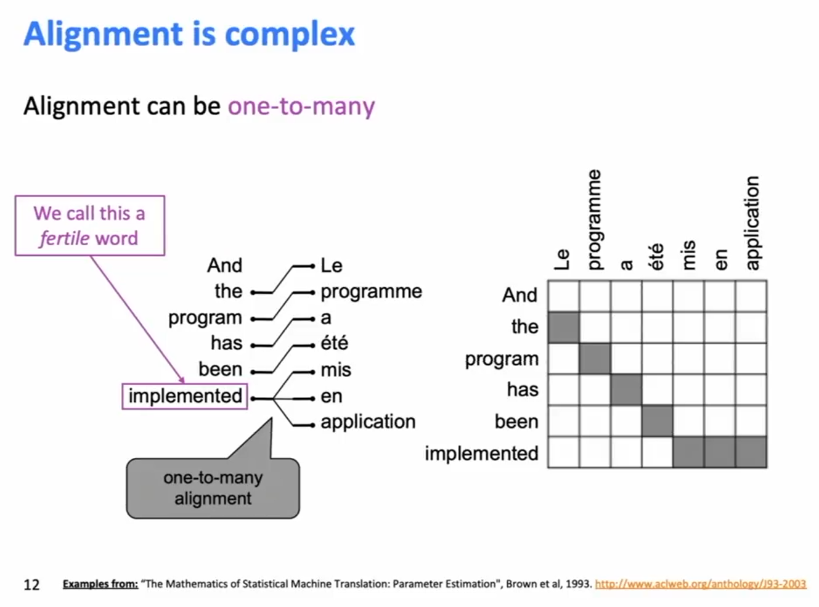
Alignment is complex

Slide 12
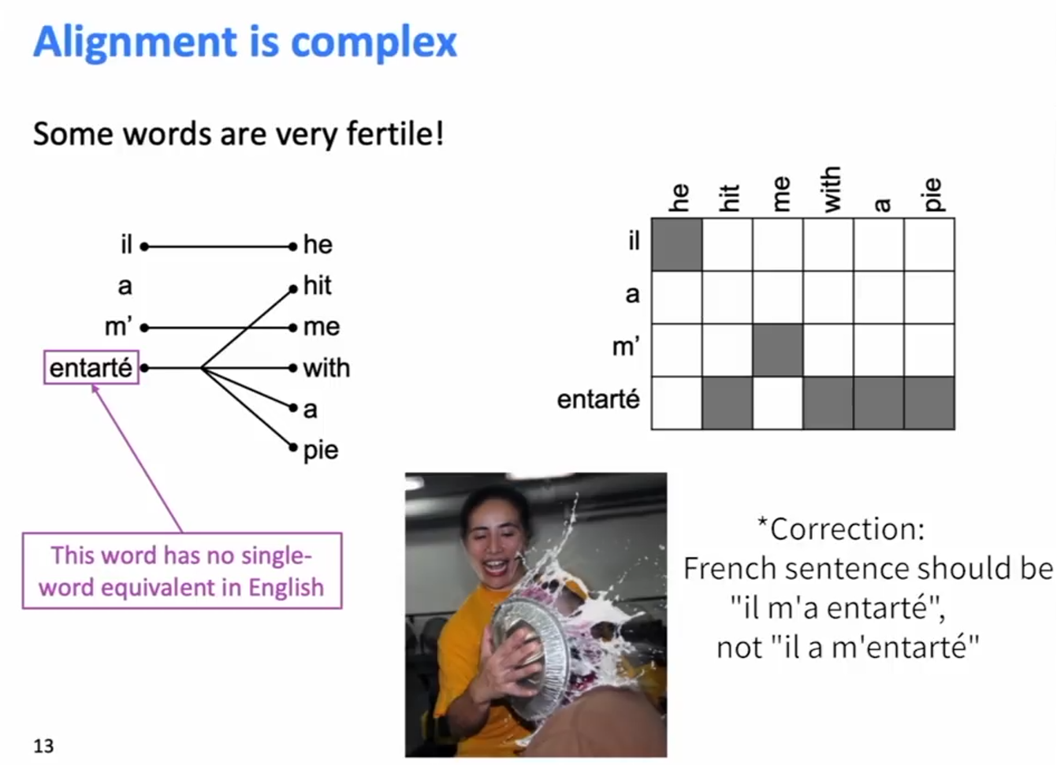
Alignment is complex

Slide 13
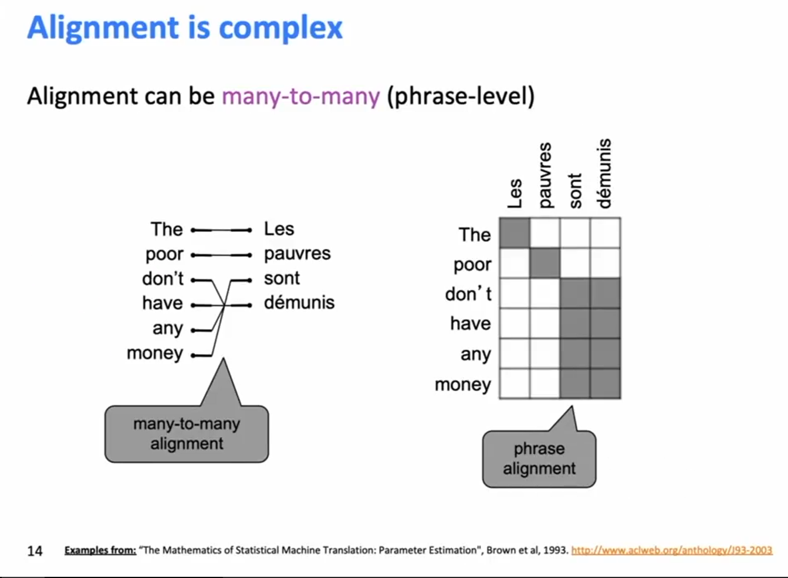
Alignment is complex

Slide 14
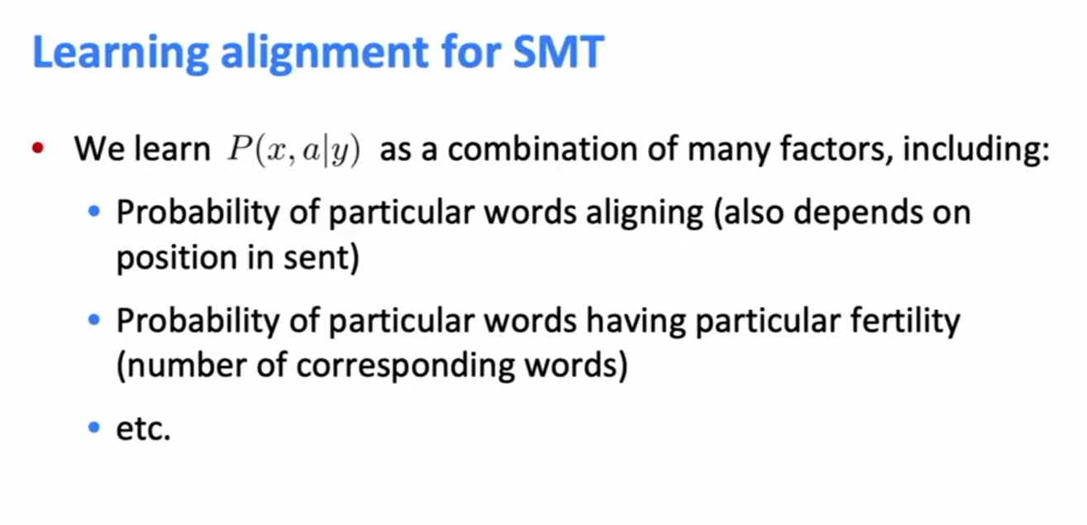
Learning alignment for SMT

Slide 15
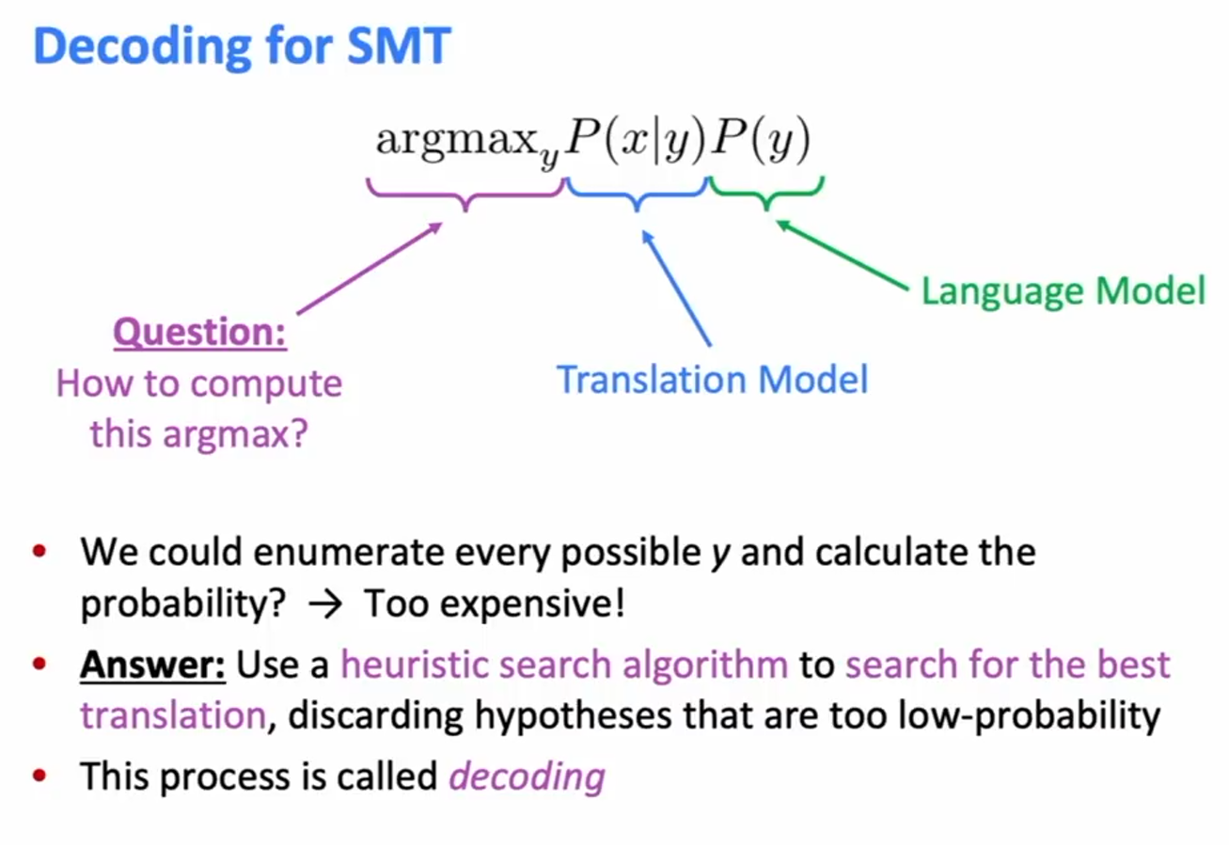
Decoding for SMT

Slide 16
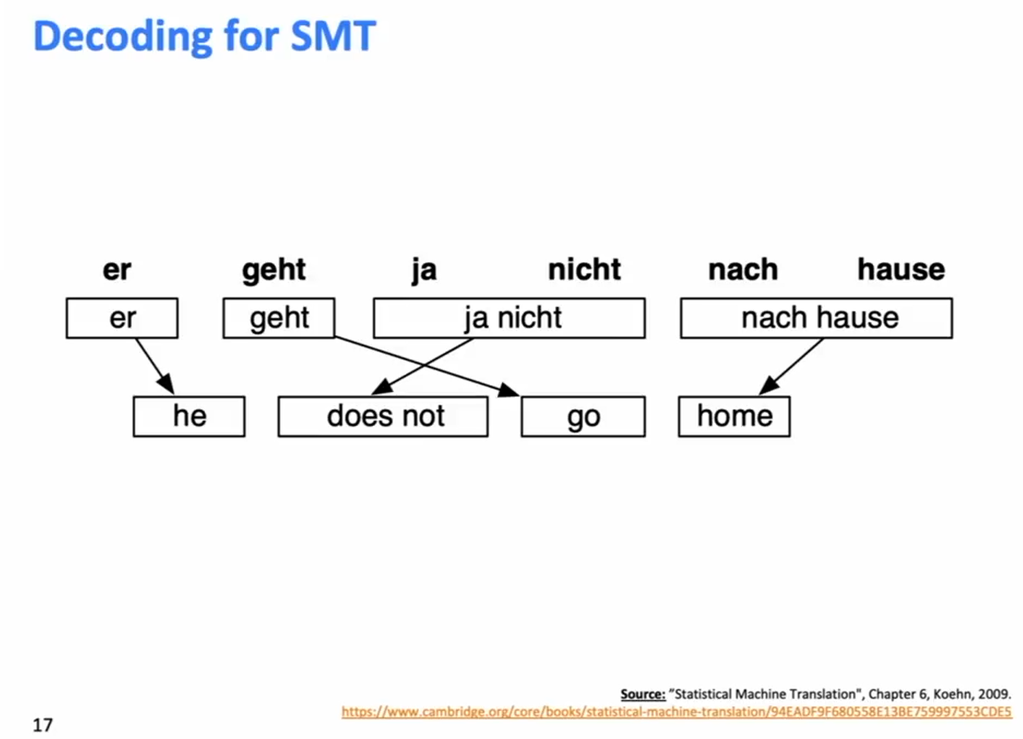
Decoding for SMT

Slide 17
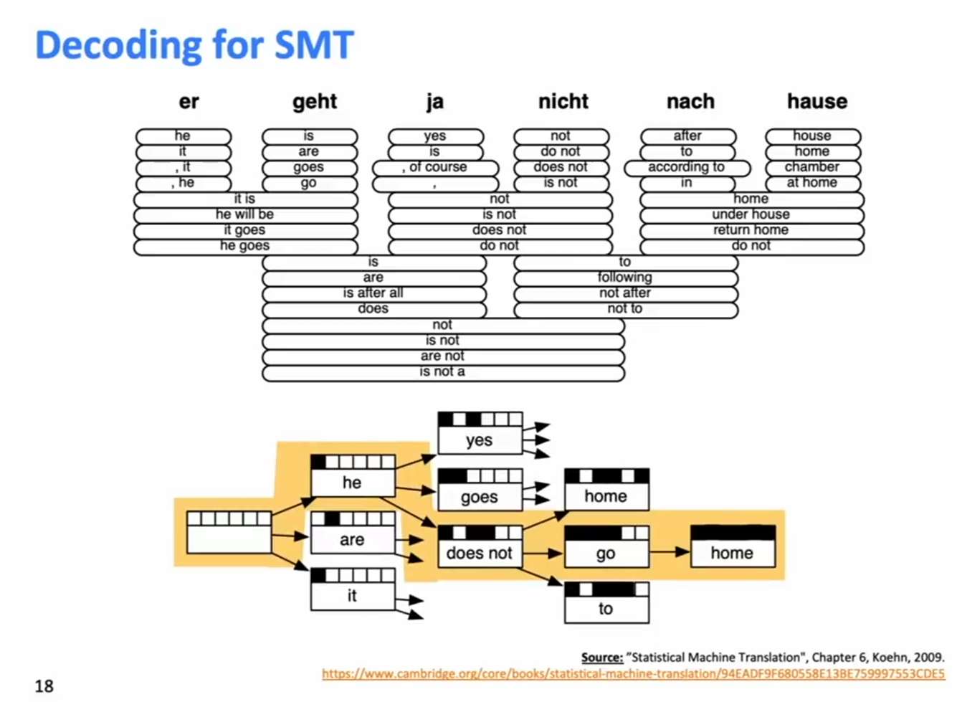
Decoding for SMT

Slide 18
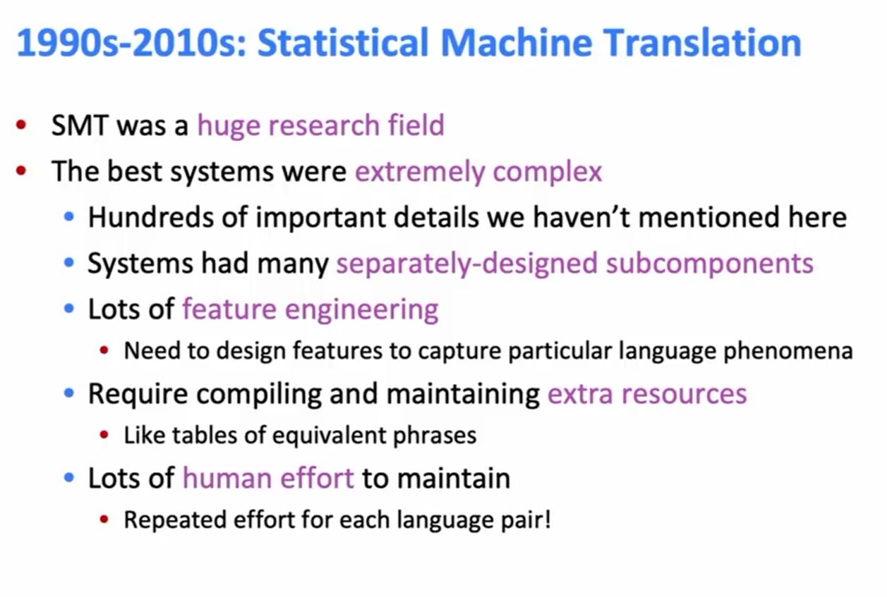
1990s-2010s: Statistical Machine Translation

Slide 19


Slide 20
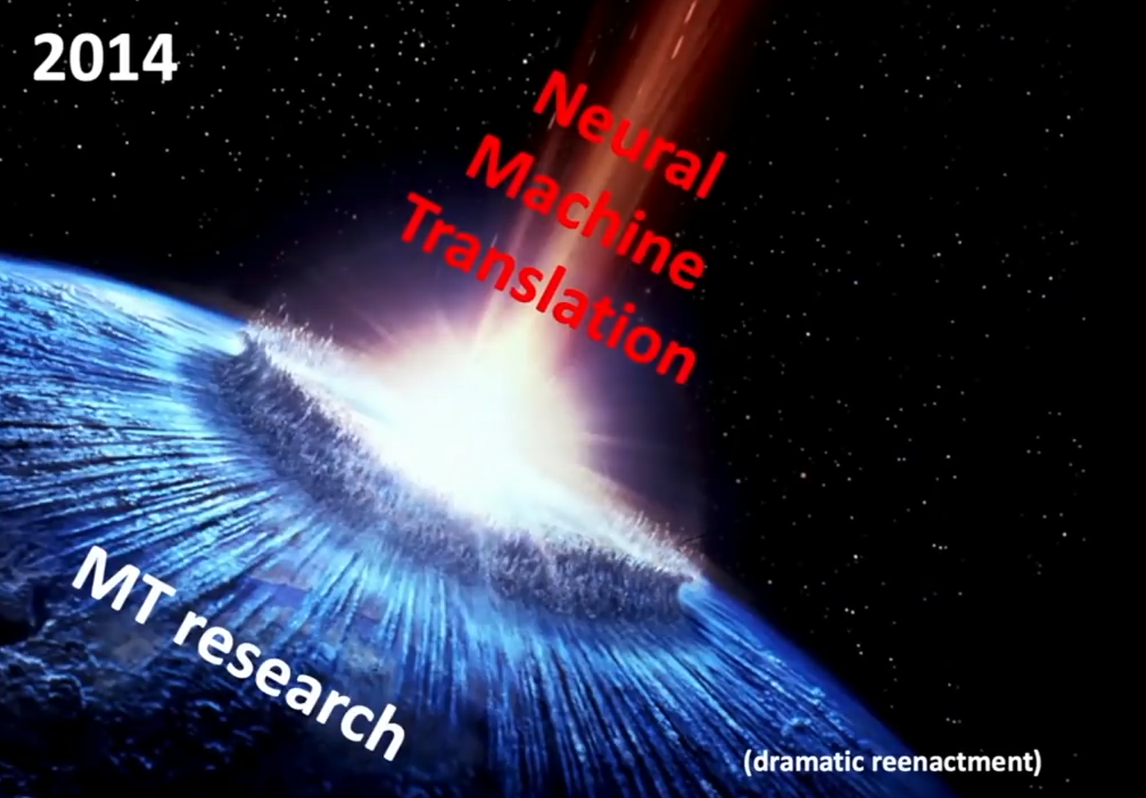

Slide 21
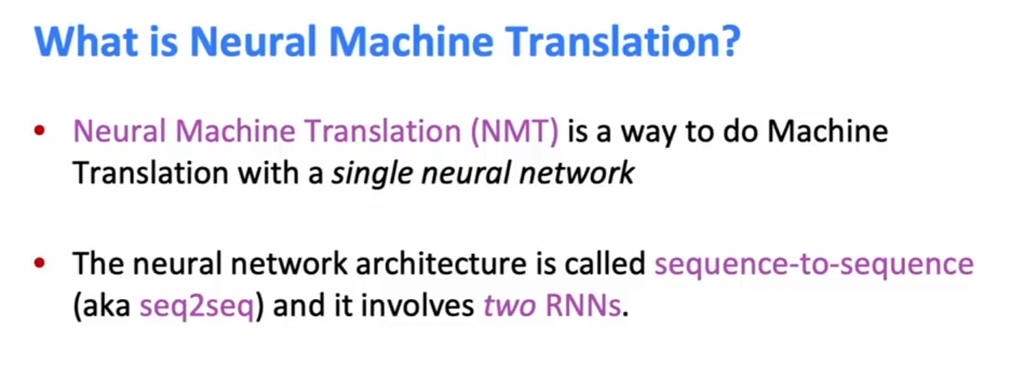
What is Neural Machine Translation?

Slide 22
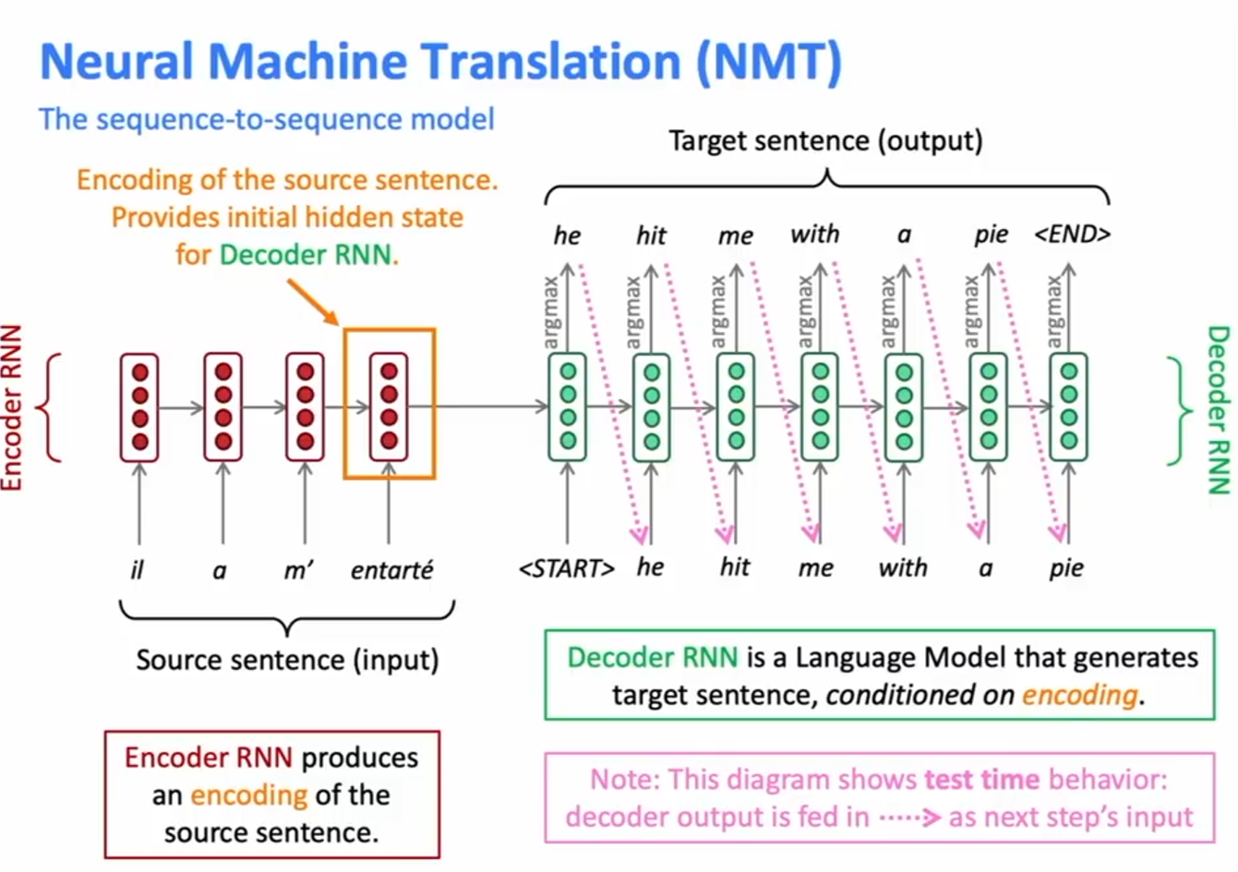
Neural Machine Translation (NMT) – The sequence-to-sequence model

Slide 23
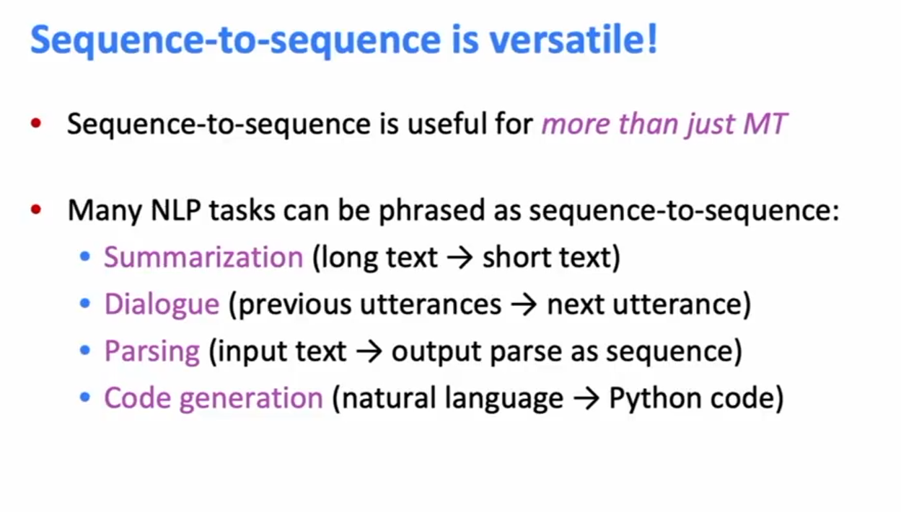
Sequence-to-sequence is versatile!

Slide 24
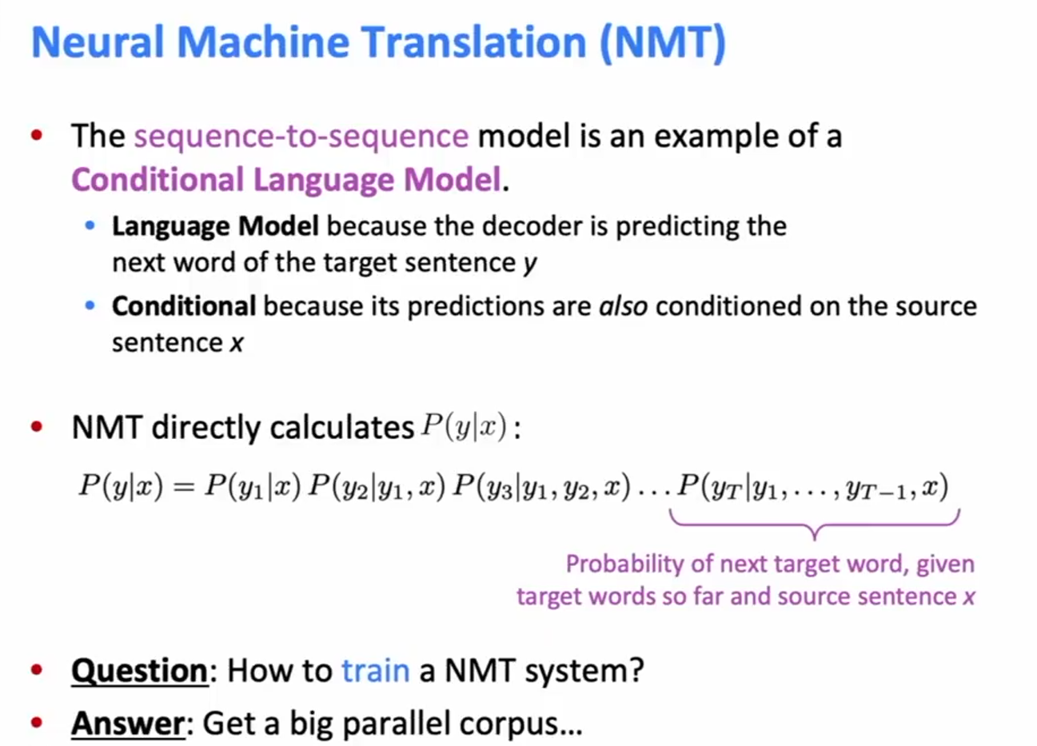
Neural Machine Translation (NMT)

Slide 25
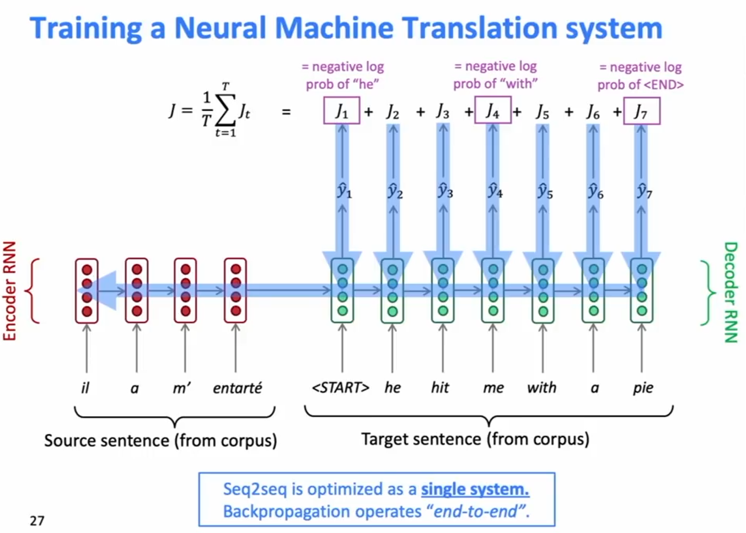
Training a Neural Machine Translation System

Slide 26
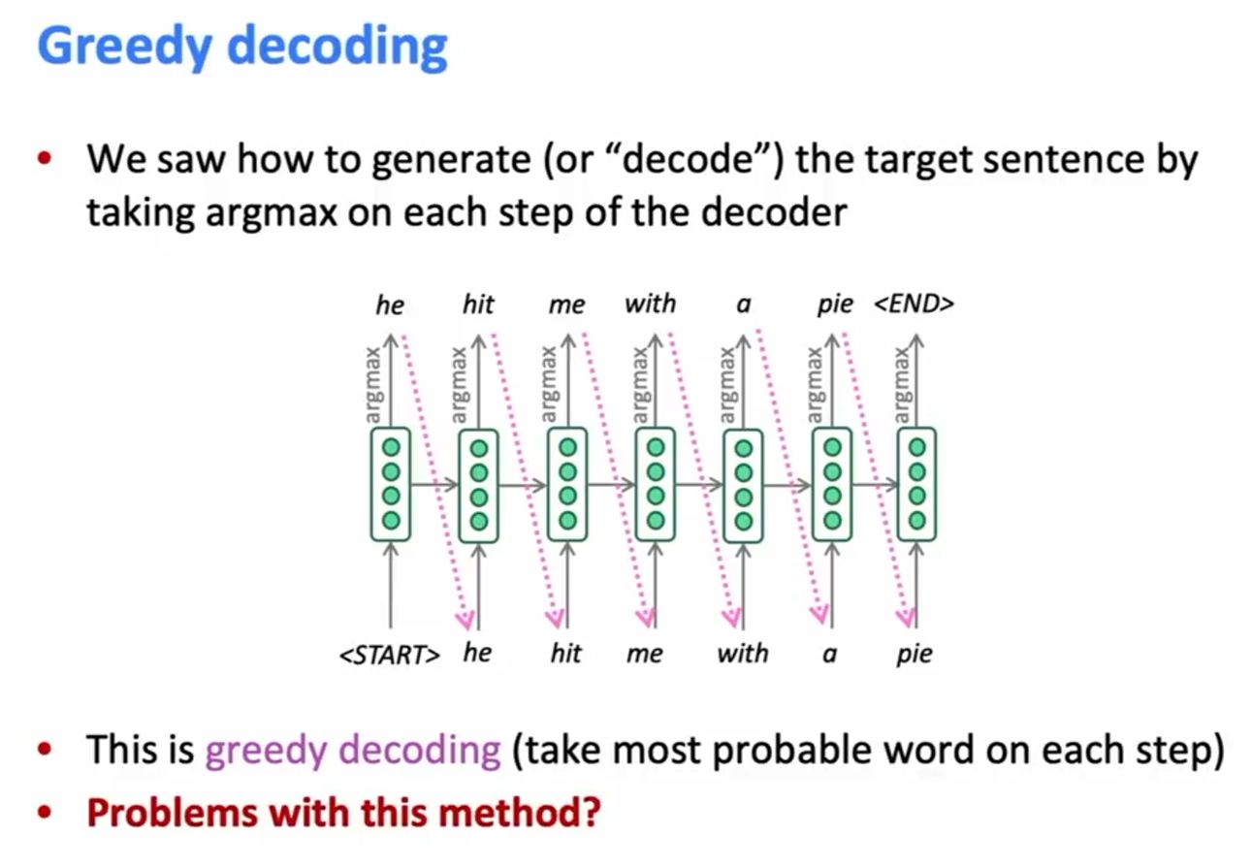
Greedy decoding

Slide 27
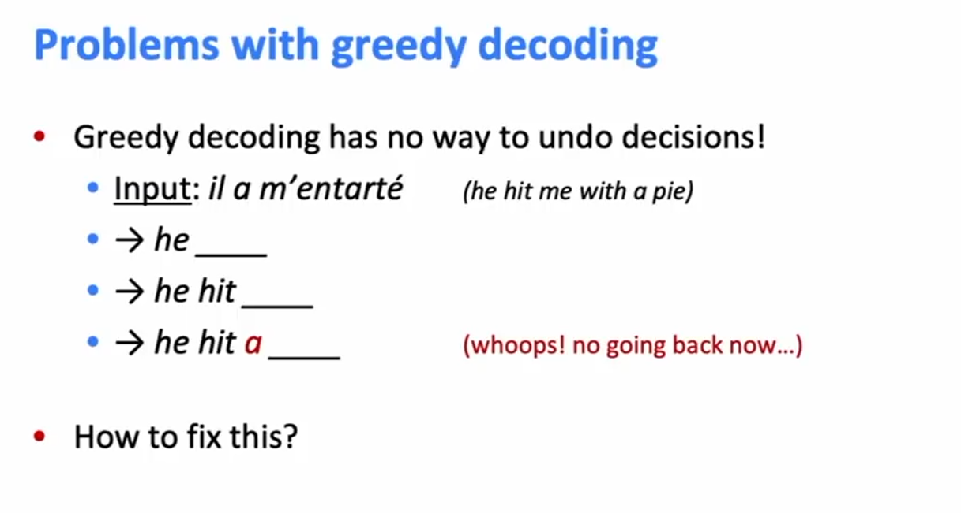
Problems with greedy decoding

Slide 28
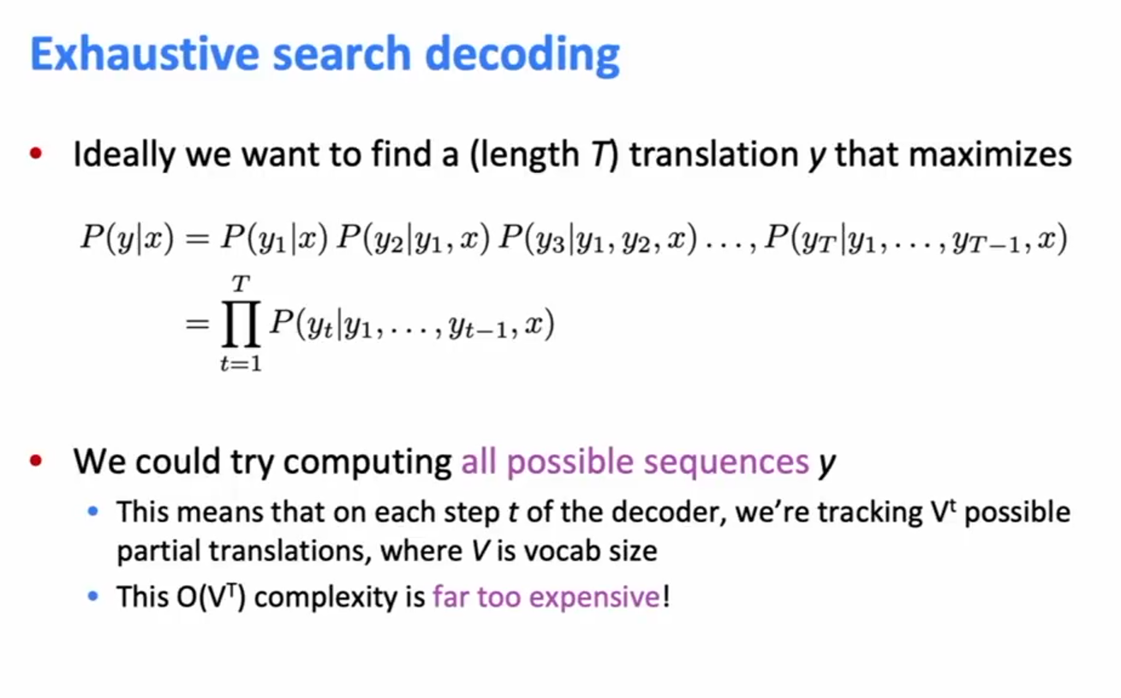
Exhaustive search decoding

Slide 29
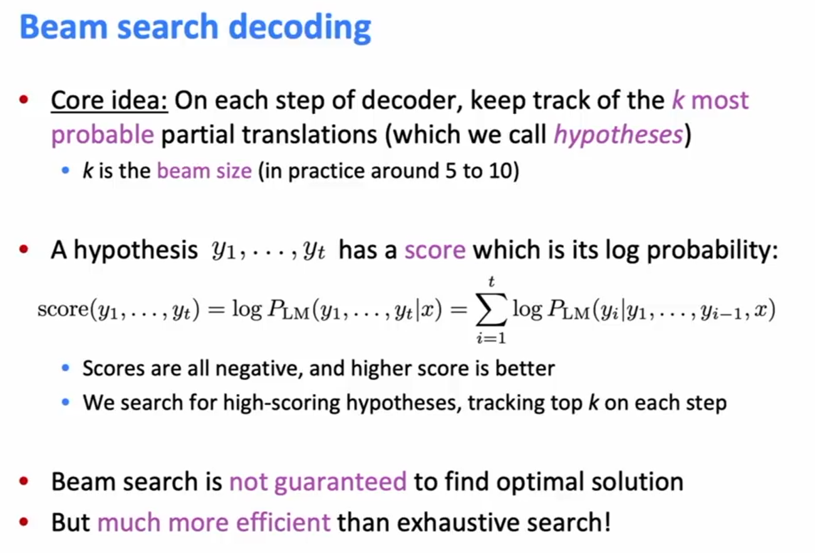
Beam search decoding

Slide 30
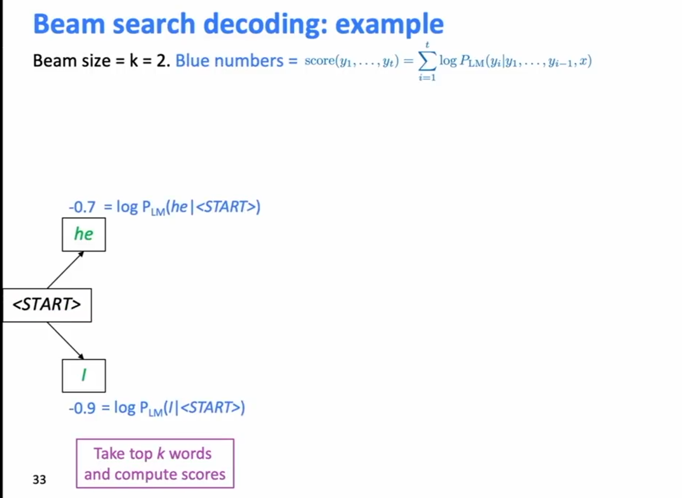
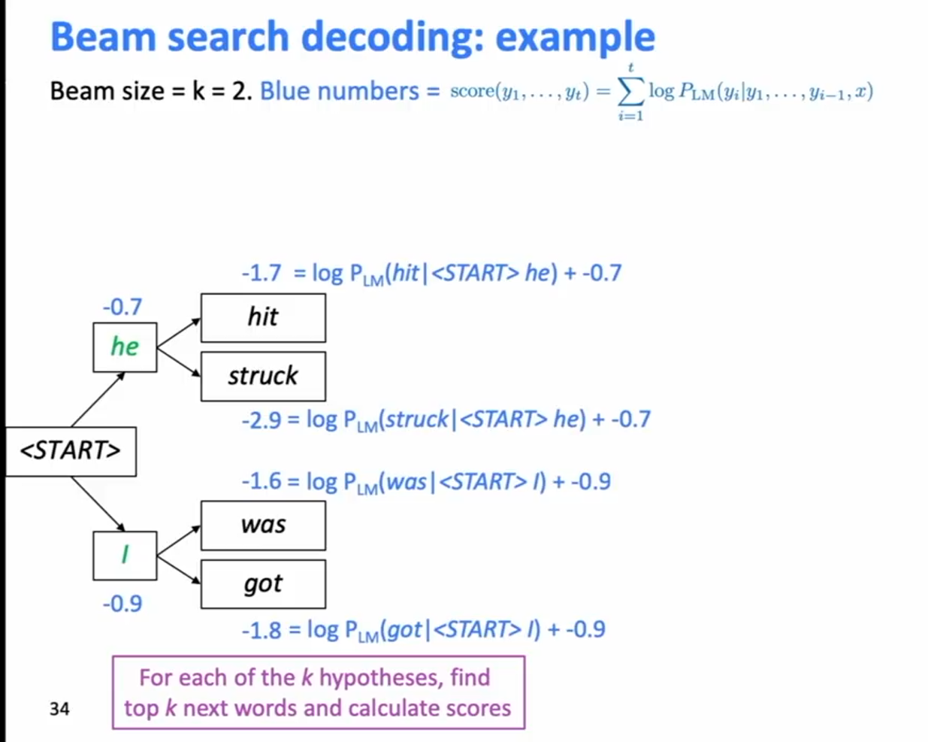
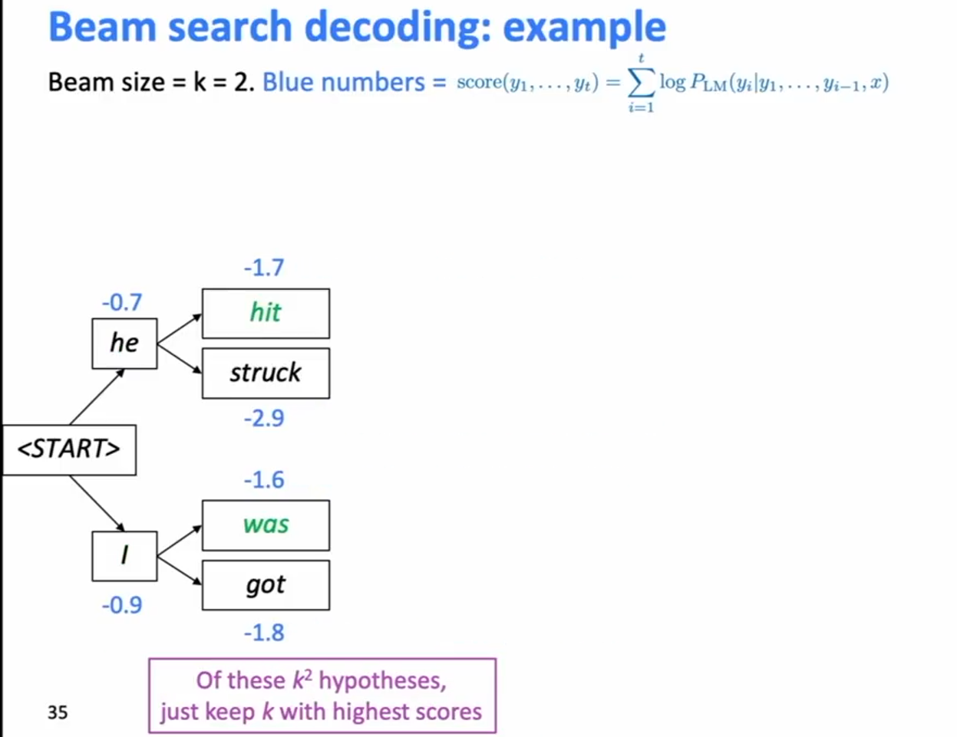
Beam search decoding: example

Slide 31
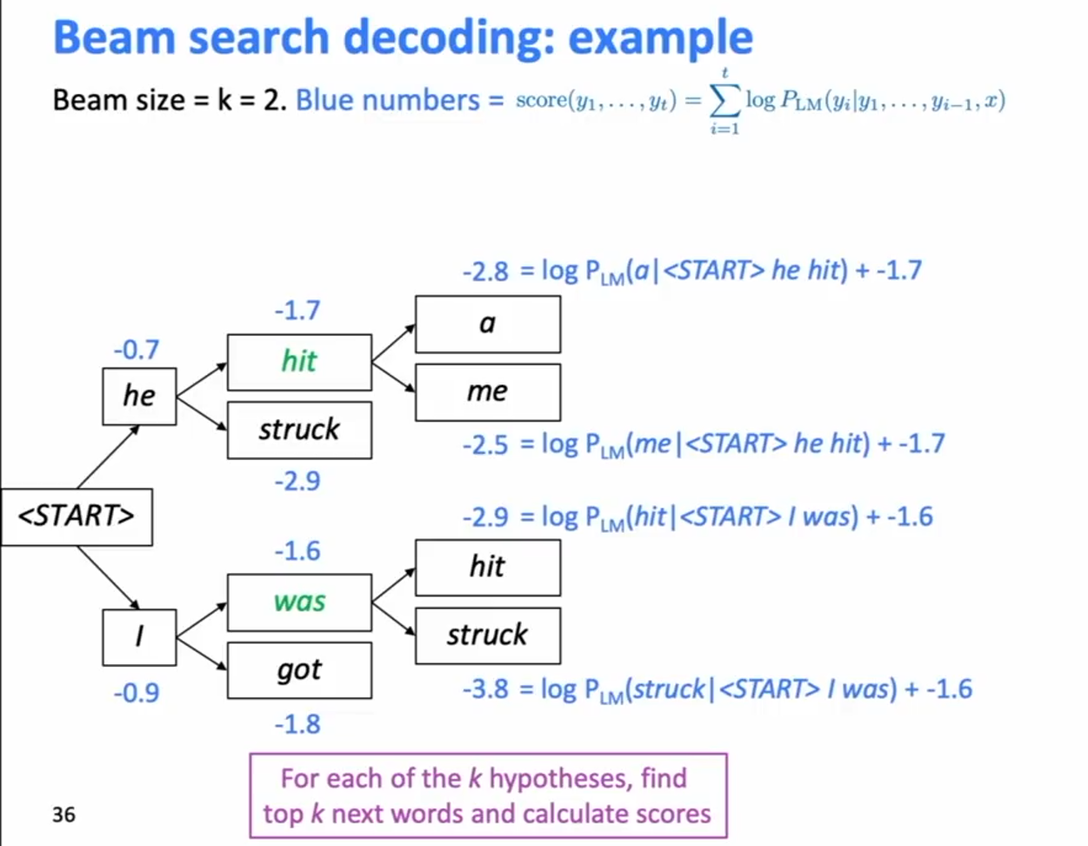
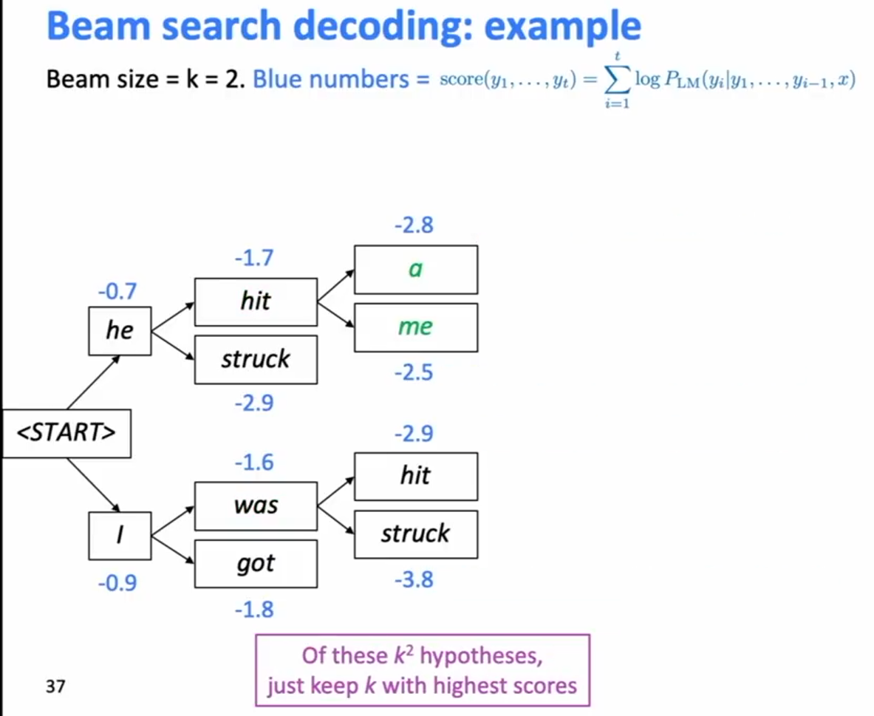
Beam search decoding: example

Slide 32
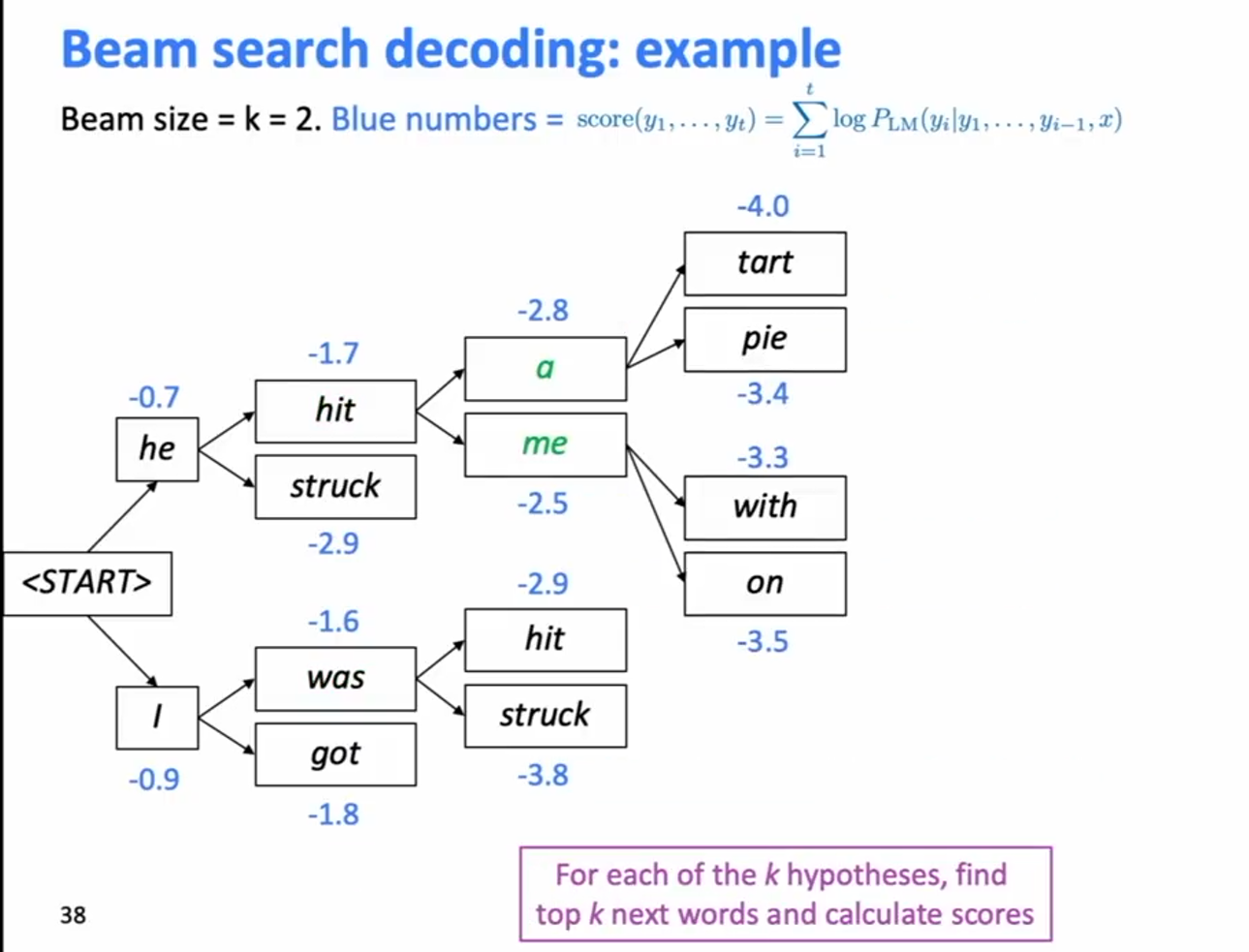
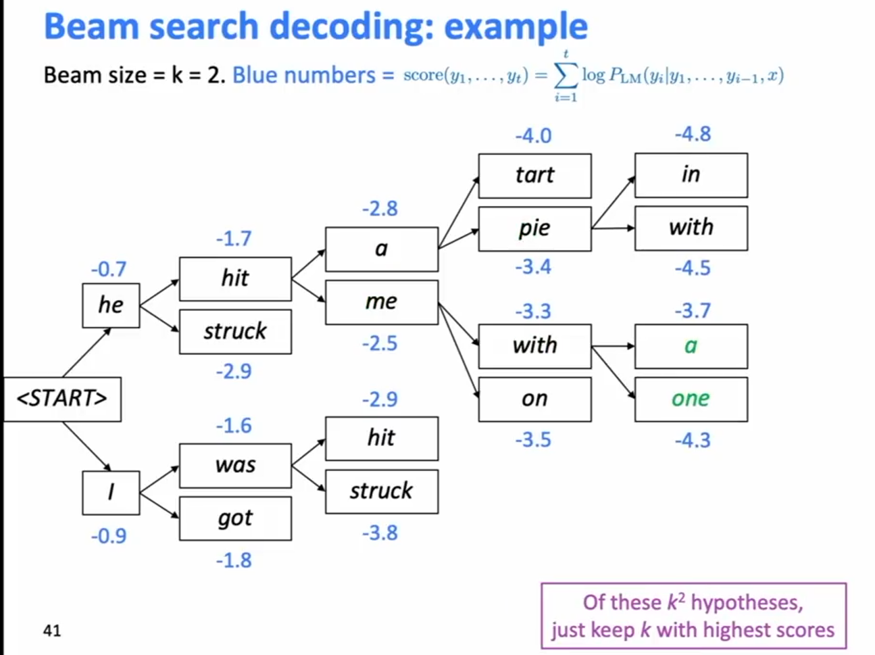
Beam search decoding: example

Slide 33
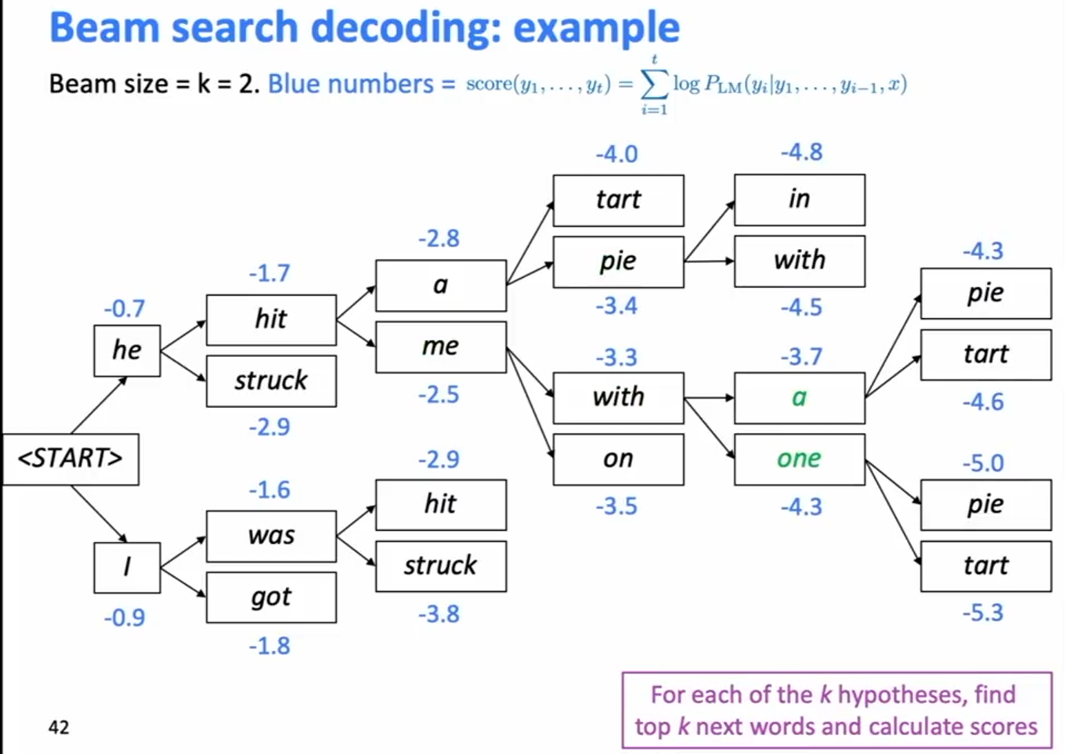
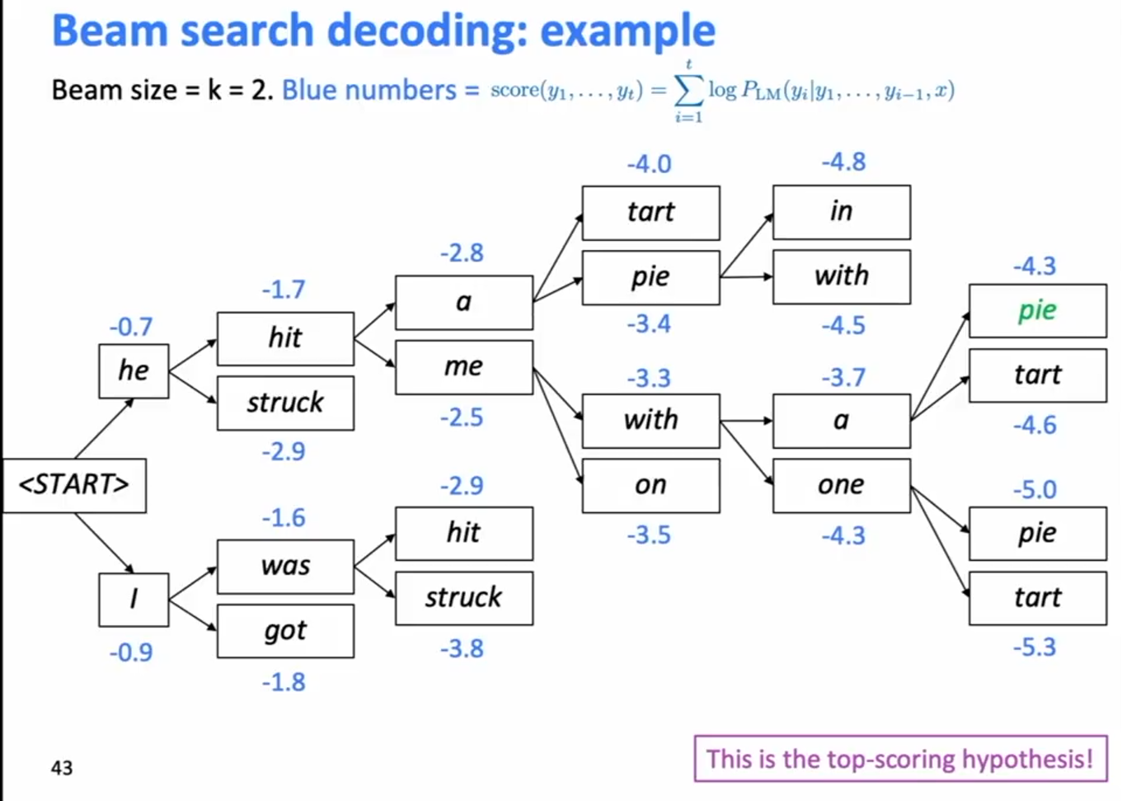
Beam search decoding: example

Slide 34
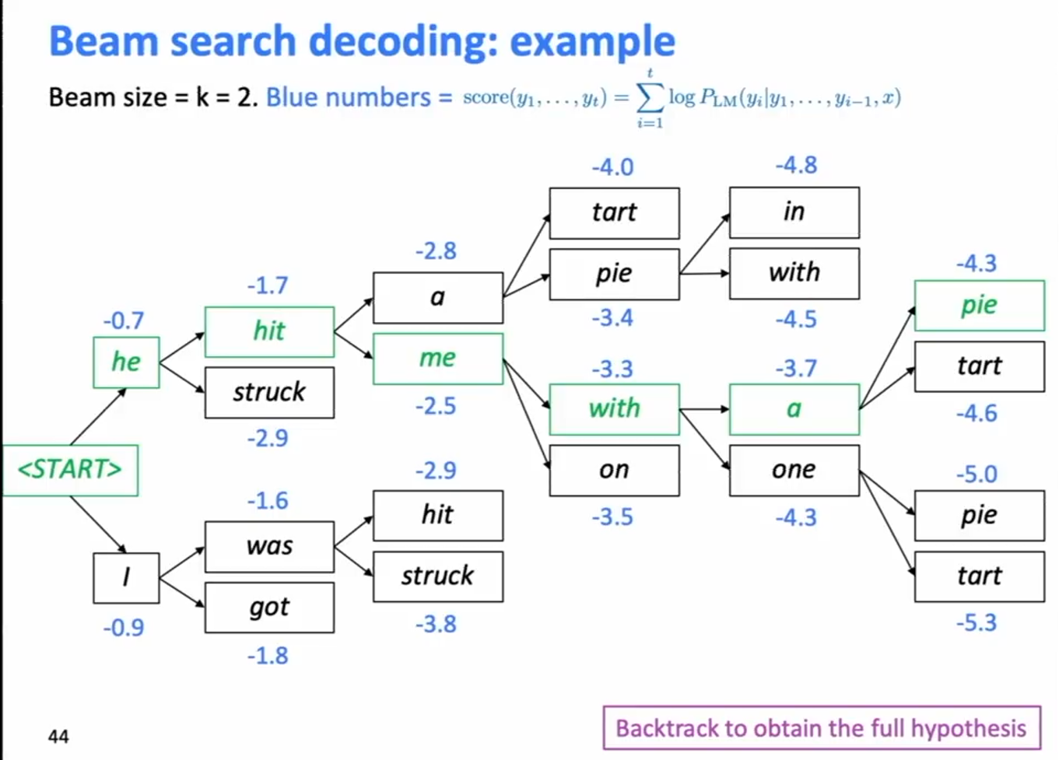
Beam search decoding: example

Slide 35
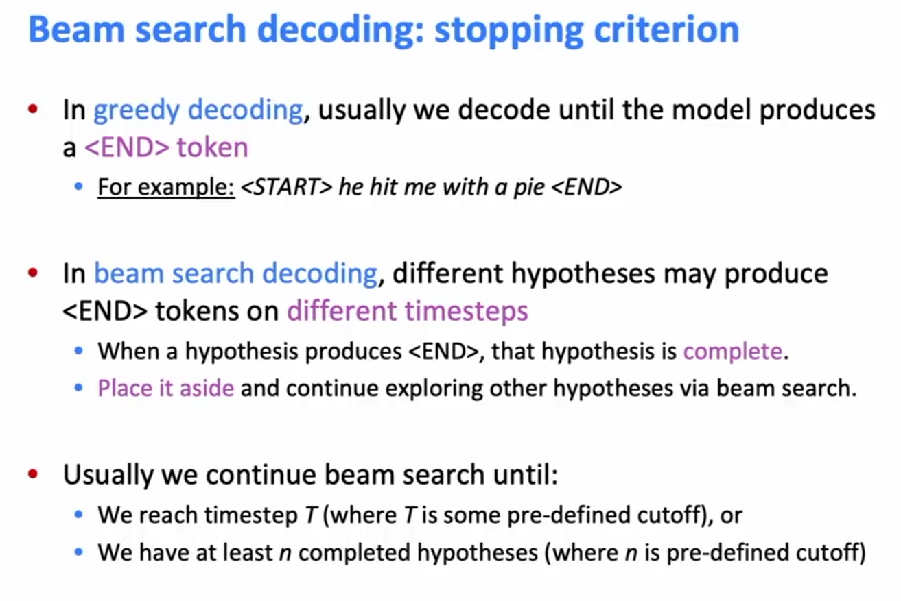
Beam search decoding: stopping criterion

Slide 36
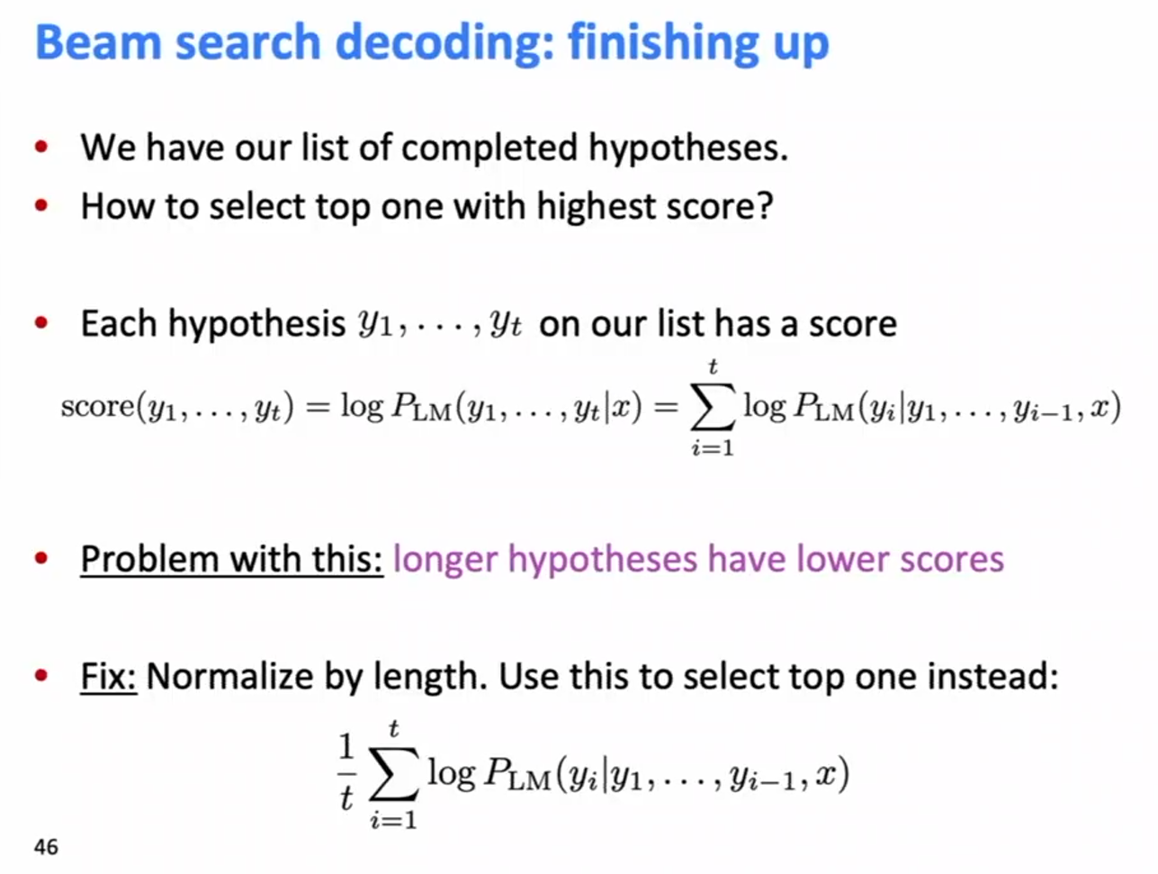
Beam search decoding: finishing up

Slide 37
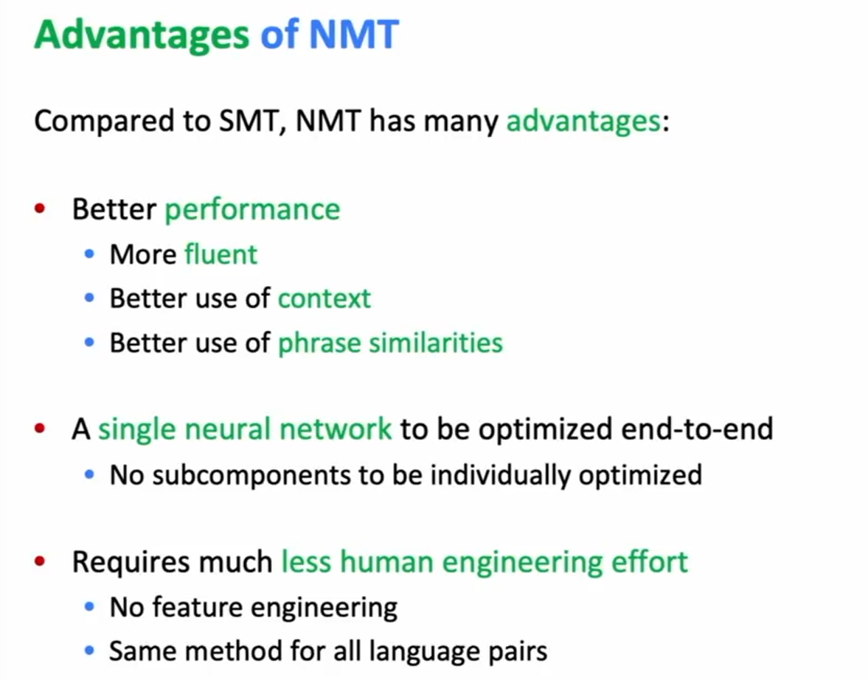
Advantages of NMT

Slide 38
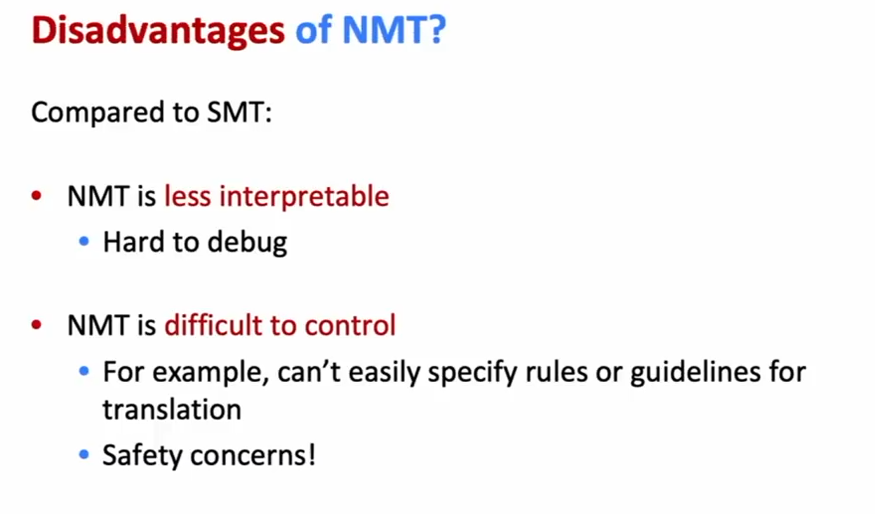
Disadvantages of NMT?

Slide 39
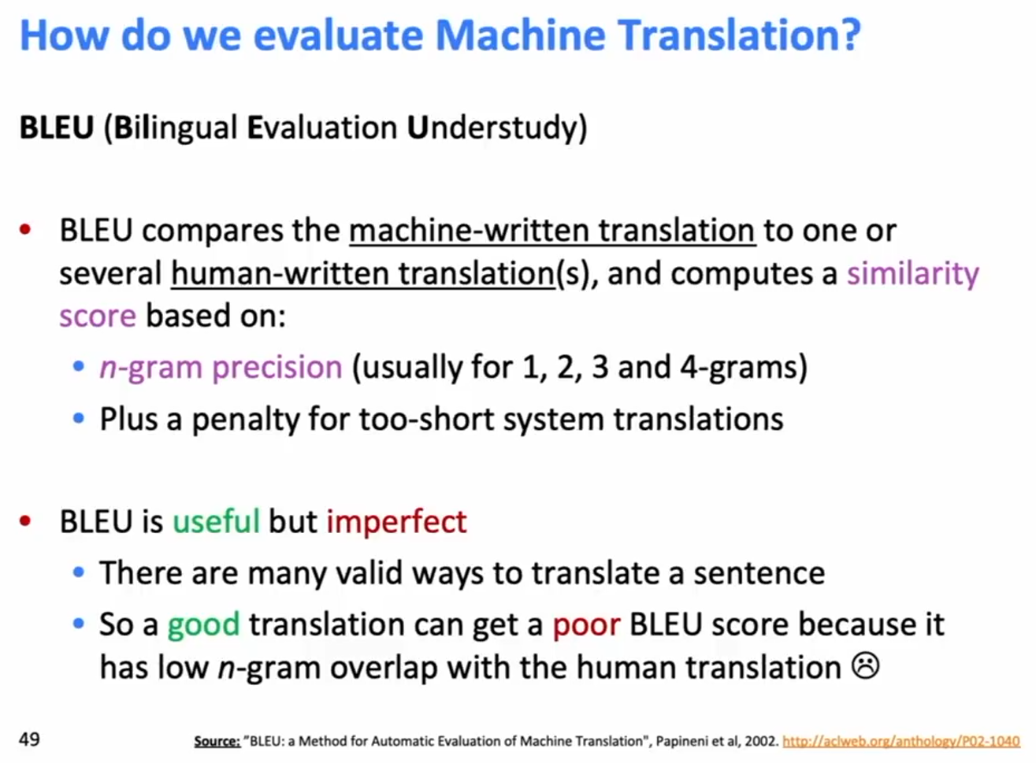
How do we evaluate Machine Translation?

Slide 40
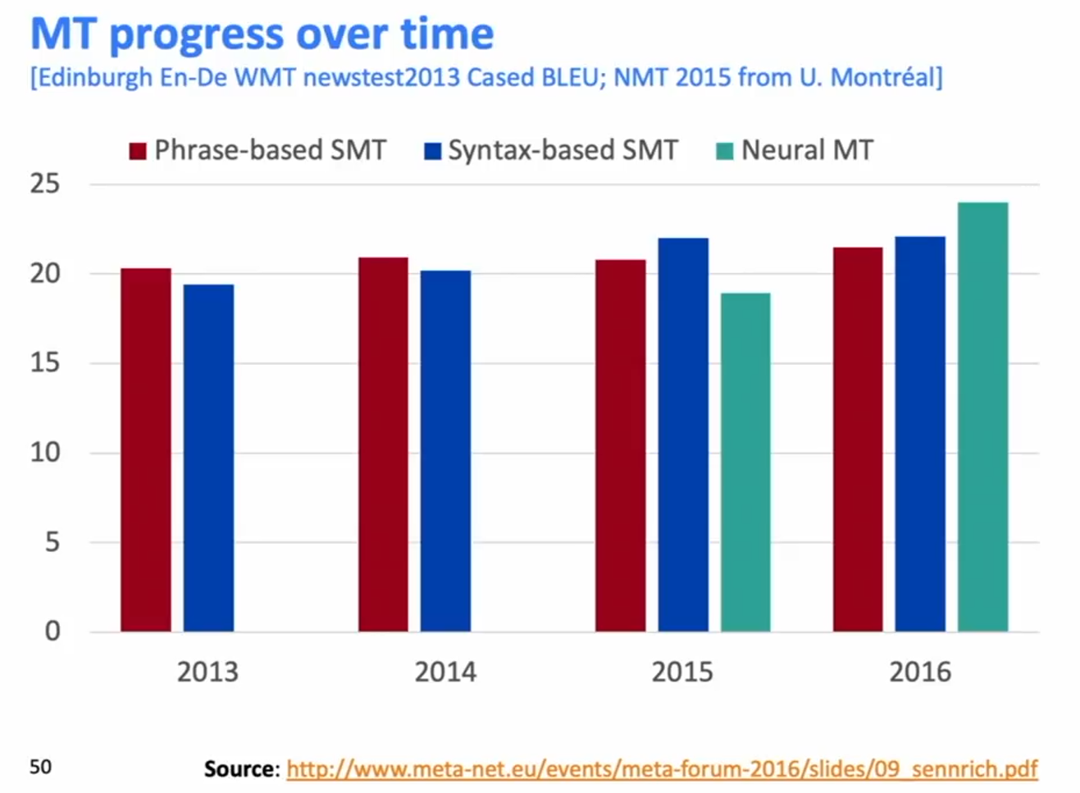
MT progress over time

Slide 41
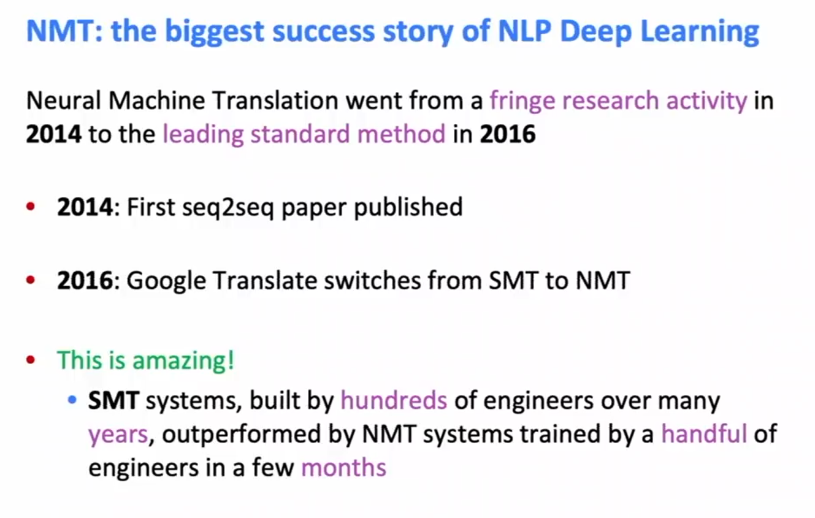
NMT: the biggest success story of NLP Deep Learning

Slide 42
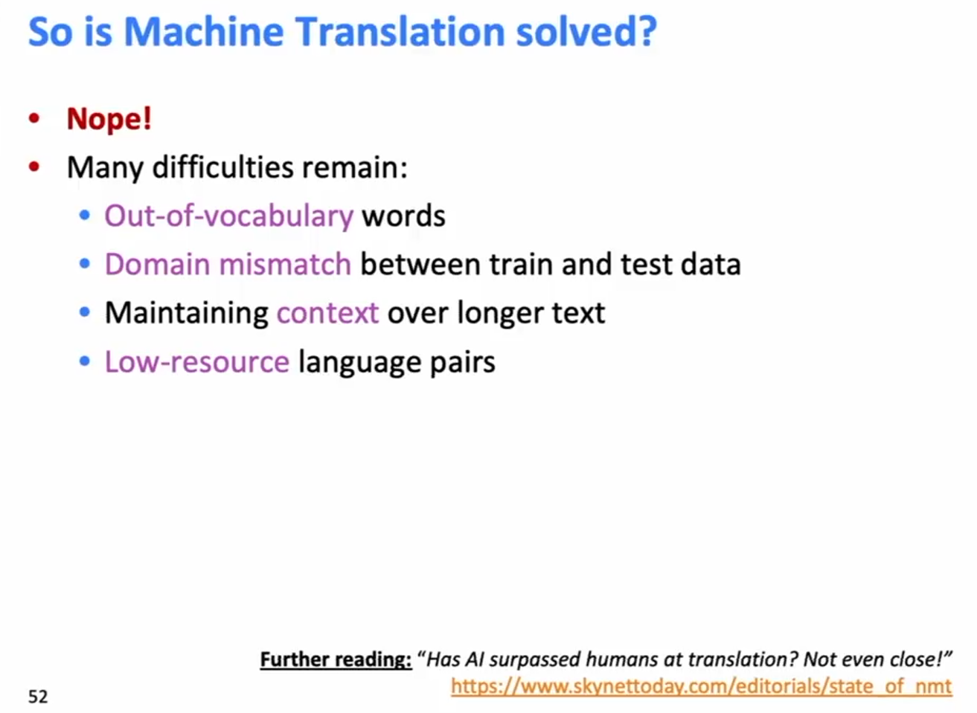
So is Machine Translation solved?

Slide 43
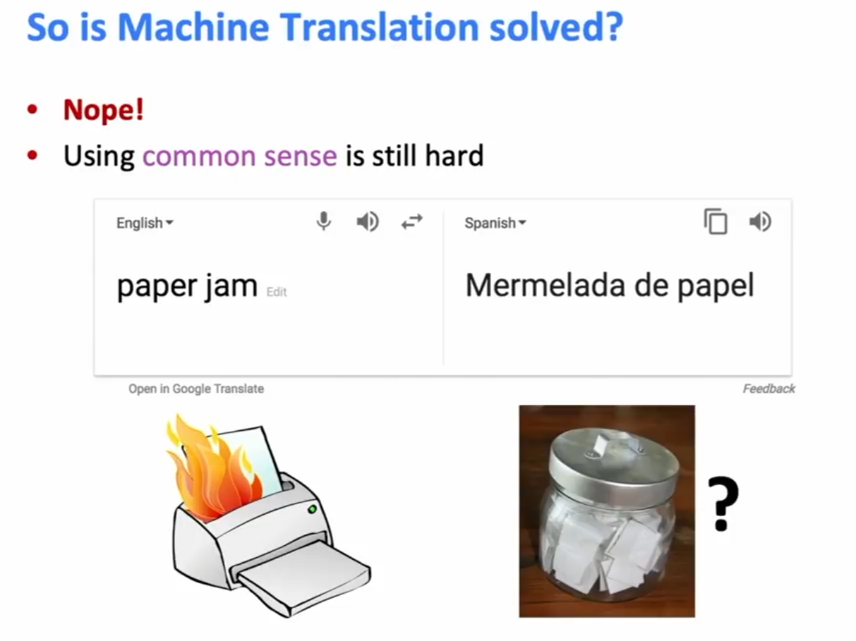
So is Machine Translation solved?

Slide 44
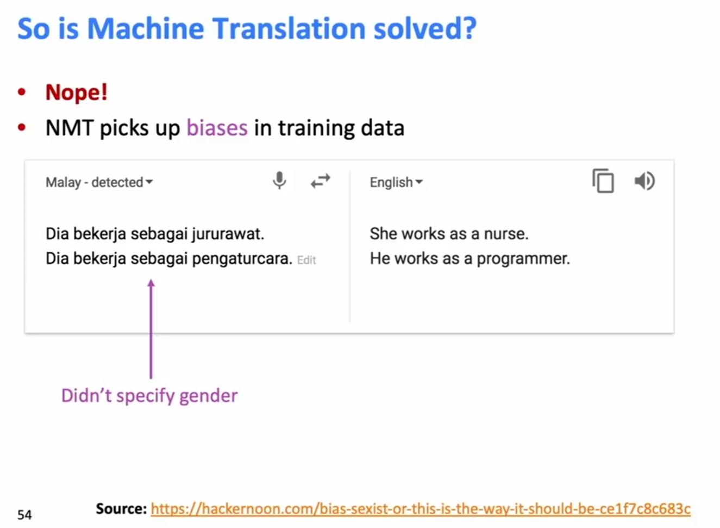
So is Machine Translation solved?

Slide 45
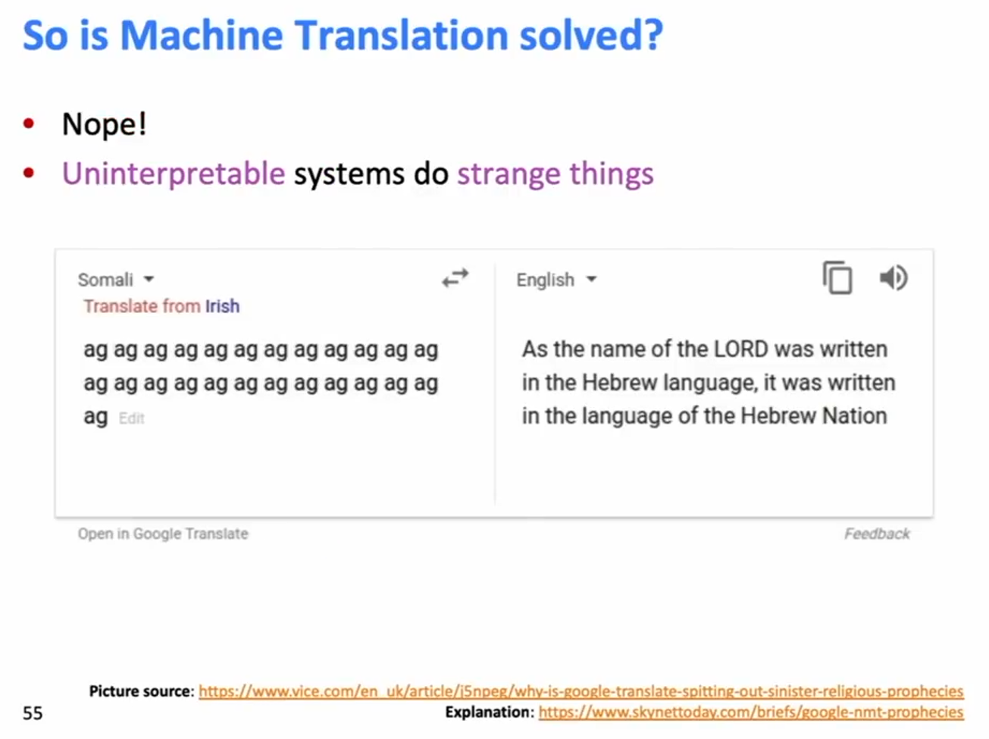
So is Machine Translation solved?

Slide 46
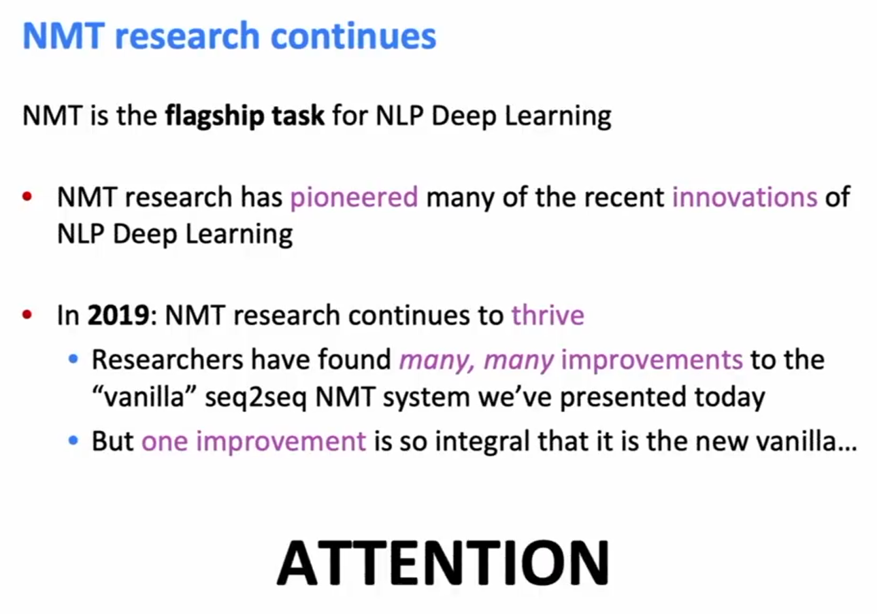
NMT research continues

Slide 47
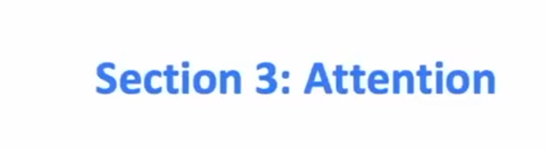

Slide 48
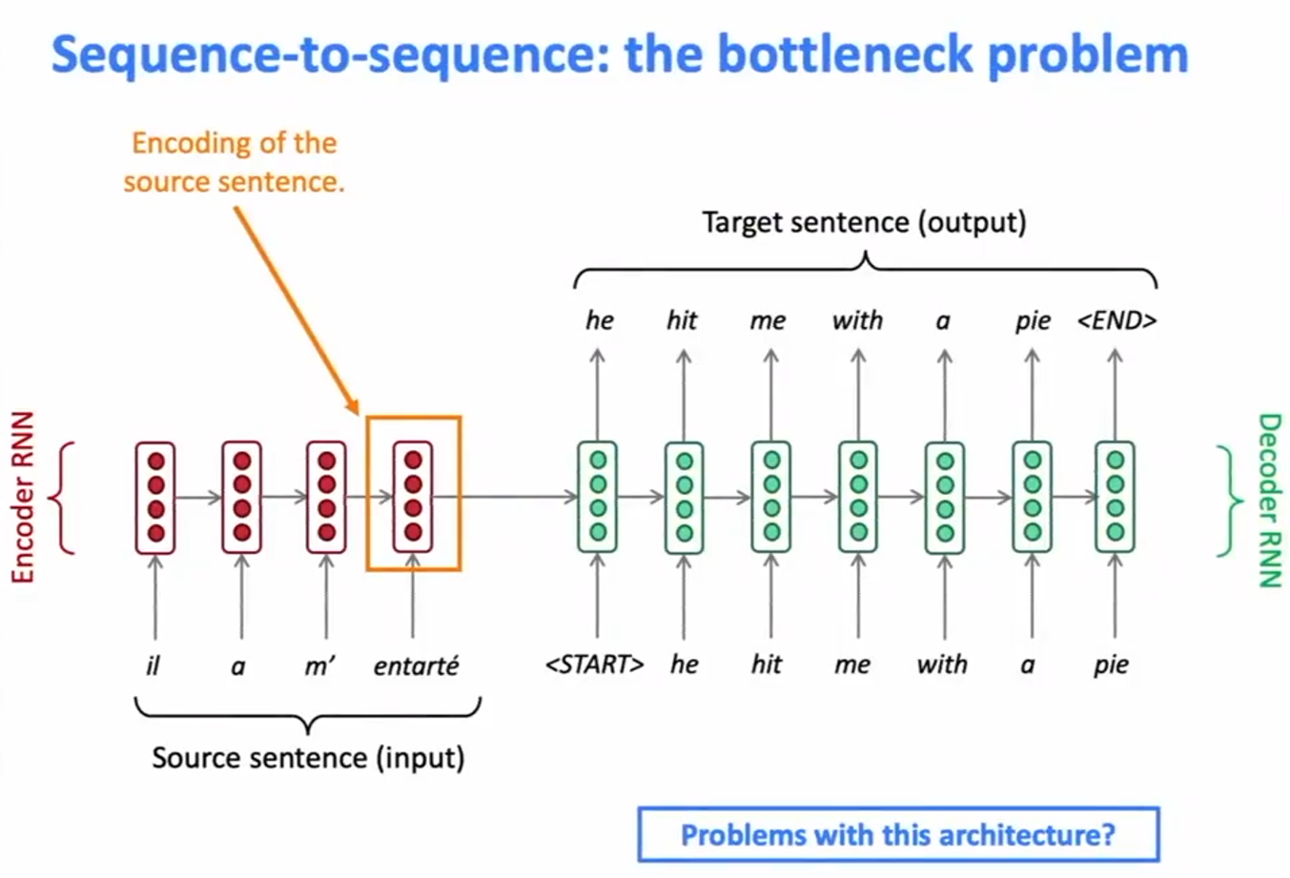
Sequence-to-Sequence: the bottleneck problem

Slide 49

Sequence-to-Sequence: the bottleneck problem

Slide 50

Attention

Slide 51


Sequence-to-Sequence with attention

Slide 52

Sequence-to-Sequence with attention

Slide 53

Sequence-to-Sequence with attention

Slide 54

Sequence-to-Sequence with attention

Slide 55

Sequence-to-Sequence with attention

Slide 56

Sequence-to-Sequence with attention

Slide 57

Sequence-to-Sequence with attention

Slide 58

Sequence-to-Sequence with attention

Slide 59

Sequence-to-Sequence with attention

Slide 60

Attention: in equations

Slide 61

Attention is great

Slide 62

Attention is a general Deep Learning technique

Slide 63

Attention is a general Deep Learning technique

Slide 64

There are several attention variants

Slide 65

Attention variants

Slide 66

Summary of today’s lecture

